Slide 1
Antibiotic Domain

Slide 2
Background: Antibiotic Domain
In the majority of cases of CAP, no microbiological diagnosis is made.
Empiric antibiotic therapy is almost always commenced before a microbiological diagnosis is available
A respiratory quinolone (moxifloxacin or levofloxacin) or combination antimicrobial therapy with a beta-lactam and macrolide are both recommended treatment for CAP in national and international guidelines.
The use of these therapies is associated with mortality benefit in CAP, however whether one of these options results in lower mortality than the other remains unclear

Slide 3
Antibiotic Domain Interventions
IV Ceftriaxone plus macrolide
IV Piperacillin-tazobactam plus macrolide
IV Amoxicillin-clavulanate plus macrolide
IV Moxifloxacin (or Levofloxacin)
IV Ceftaroline plus macrolide (included in approved protocol but not available at launch)

Slide 4
Eligibility
Exclusion criteria:
Received >48h of IV antibiotic treatment for this illness
More than 24h has elapsed since ICU admission
A specific antibiotic is indicated
E.g. suspected or proven concomitant infection, suspected or proven infection with resistant bacteria, febrile neutropenia or immune suppression, melioidosis, or sufficient microbiological information to guide antibacterial therapy

Slide 5
Eligibility
Exclusion criteria:
Treating clinician believes that participation is not in the patient’s best interest
Intervention exclusion criteria:
Known hypersensitivity to an intervention at the site
Patients must be eligible for at least two interventions to be randomised into the domain

Slide 6
Interventions
Antibiotic dose and frequency is at the discretion of the treating clinician
What you or local guidelines would recommend
Adjust for weight and clearance as you would normally do
Recommended doses in protocol, including adjustment for renal function provided

Slide 7
Recommended antibiotic dose and frequency
R

Slide 8
Interventions
Macrolide Administration
If allocated to any of beta-lactam arms must also receive a macrolide
Site's preferred macrolide
IV (at least initially) preferred over enteral
Azithromycin preferred over others. Erythromycin is permitted but excludes from macrolide domain

Slide 9
Interventions
Macrolide preference:
IV azithromycin
IV clarithromycin
Enteral azithromycin
Enteral azithromycin or roxithromycin
IV or enteral erythromycin

Slide 10
Interventions
Duration of therapy
As determined by treating clinician
Change to any antibiotic if microbiological diagnosis made
Switch from IV to enteral / oral when clinically appropriate
Cease antibiotics if alternative diagnosis made
Cease antibiotics when sufficient clinical response has occurred

Slide 11
Interventions
Changes to empiric antibiotic therapy:
Treating clinicians need to document (in the patient’s medical record) the reason for ANY change to antibiotic therapy while the patient was in the ICU.

Slide 12
Concomitant Care
Permitted additional antibiotics:
If suspected MRSA, add vancomycin, linezolid or other antibacterial active against MRSA (but not ceftaroline)
Other beta-lactams, carbapenems, monobactams or quinolones not permitted (unless based on results of microbiological tests)
If allocated to moxifloxacin or levofloxacin, addition of macrolide, beta-lactam, carbapenem, or monobactam not permitted
Additional aminoglycoside, clindamycin, cotrimoxazole all permitted
If immune-suppressed should have been excluded from domain
If site has resistance pattern for CAP organisms that is not appropriate for at least two antibiotic interventions, site should not participate in the domain

Slide 13
End-point
Primary endpoint
All-cause mortality at day 90

Slide 14
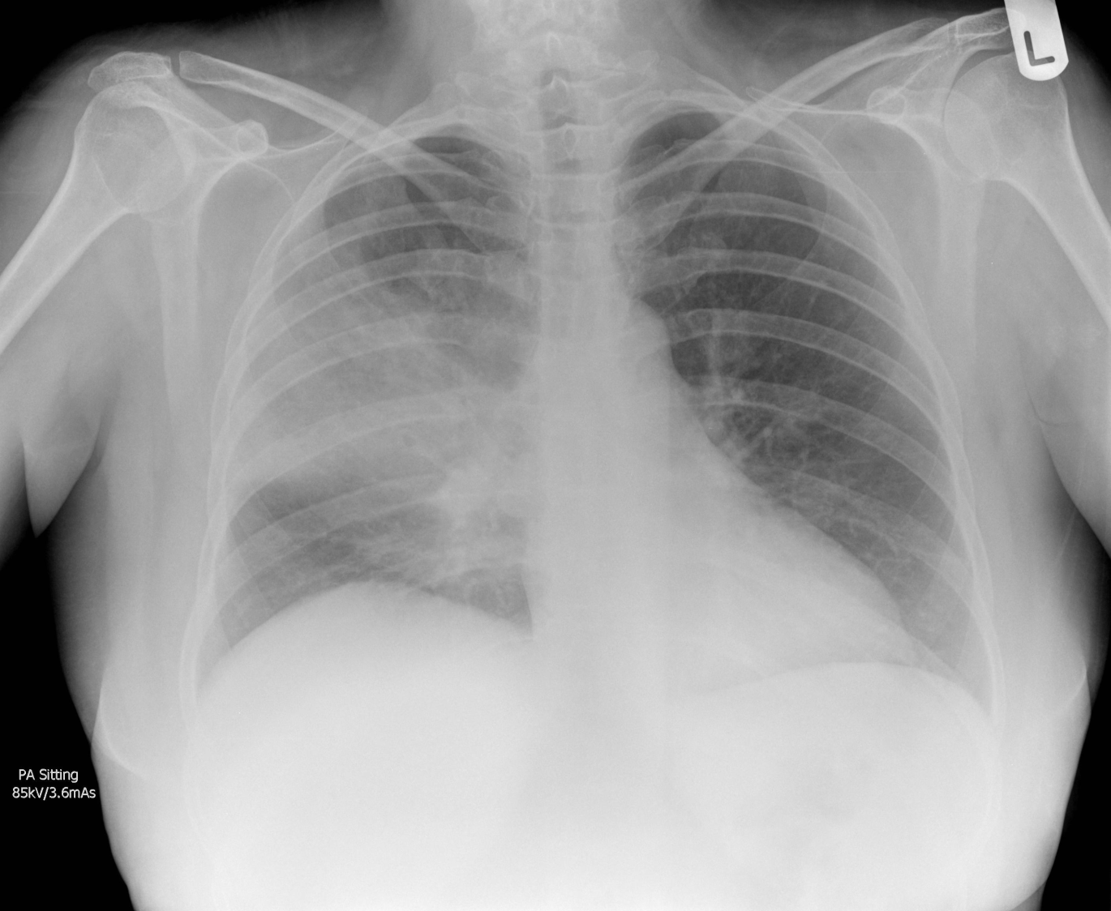
Questions?
Randomized, Embedded, Multifactorial, Adaptive Platform
For Community-Acquired Pneumonia

