Slide 1
Influenza Antiviral Domain

Slide 2
Background
Seasonal influenza is estimated to cause approximately 300,000 to 650,000 deaths worldwide annually
Currently, recommended antiviral agents for influenza (oseltamivir) have not been studied in placebo controlled randomised trials to demonstrate survival benefit in hospitalized patients with influenza
Widely used in clinical practice

Slide 3
Background
Baloxavir is a newly approved antiviral with evidence of benefit in outpatients on time-to-symptom resolution, but no evidence of benefit in inpatients
Whether it has value by itself, or in combination with oseltamivir, in inpatients is an open question

Slide 4
Influenza Antiviral Interventions
No antiviral agents active against influenza
5-days of oseltamivir*
10-days of oseltamivir
Baloxavir
Baloxavir + 5 days oseltamivir
Baloxavir + 10 days oseltamivir

Slide 5
Influenza Antiviral Interventions
5-days of oseltamivir
For continuity across regions, important for all sites to participate in this intervention

Slide 6
Eligibility
Inclusion Criteria
Influenza infection is confirmed by microbiological testing
(this has been changed from the previous version to more explicitly target patients with influenza)

Slide 7
Eligibility
Exclusion Criteria
Moderate state: More than 96 hours since hospital admission
Severe: More than 48 hours since ICU admission
Already received 2 doses of oseltamivir or a dose of baloxavir
Clinician does not feel best interests in participating
Known hypersensitivity to agents
Pregnancy (baloxavir interventions only)

Slide 8
Influenza Antiviral Interventions
No antiviral agents active against influenza
5-days of oseltamivir*
10-days of oseltamivir
Baloxavir
Baloxavir + 5 days oseltamivir
Baloxavir + 10 days oseltamivir

Slide 9
No antiviral intervention
Do not prescribe any antiviral active against influenza, including oseltamivir
Withholding of antiviral agents is to continue until the end of study day 28 or hospital discharge, whichever occurs first
Administration of antiviral agents by ward staff after ICU discharge will not be considered a protocol deviation

Slide 10
Five-day oseltamivir intervention
Prescribe a 5-day course of oseltamivir commencing immediately after randomization.
  10 doses with BD administration
Dosing of oseltamivir is determined by the treating clinician
  The standard dose for adult patients is 75mg enterally BD
Cease after 5 days or hospital discharge, whichever occurs first

Slide 11
Ten-day oseltamivir intervention
Prescribe a 10-day course of oseltamivir commencing immediately after randomization.
  20 doses with BD administration
Dosing of oseltamivir is determined by the treating clinician
  The standard dose for adult patients is 75mg enterally BD
Cease after 10 days or hospital discharge, whichever occurs first

Slide 12
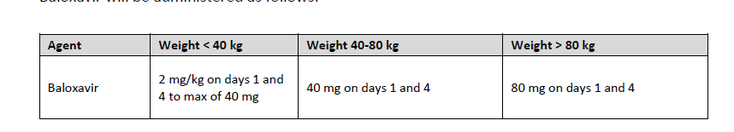
Baloxavir
Given on Day 1 & 4
Can give an added dose on day 7 if the treating clinician feels it is clinically indicated

Slide 13
Baloxavir + Oseltamivir
Baloxavir + 5 days oseltamivir
Baloxavir + 10 days oseltamivir

Slide 14
Randomization with delayed reveal
In patients with test results pending, can randomize with ‘Delayed Reveal’ when test results are available.

Slide 15
End-point
Primary endpoint
As defined in the Core Protocol

Slide 16
Drugs
Can use hospital stock of oseltamivir
Baloxavir to be supplied (supply agreements pending from Roche), or can use hospital stock, if available

Slide 17
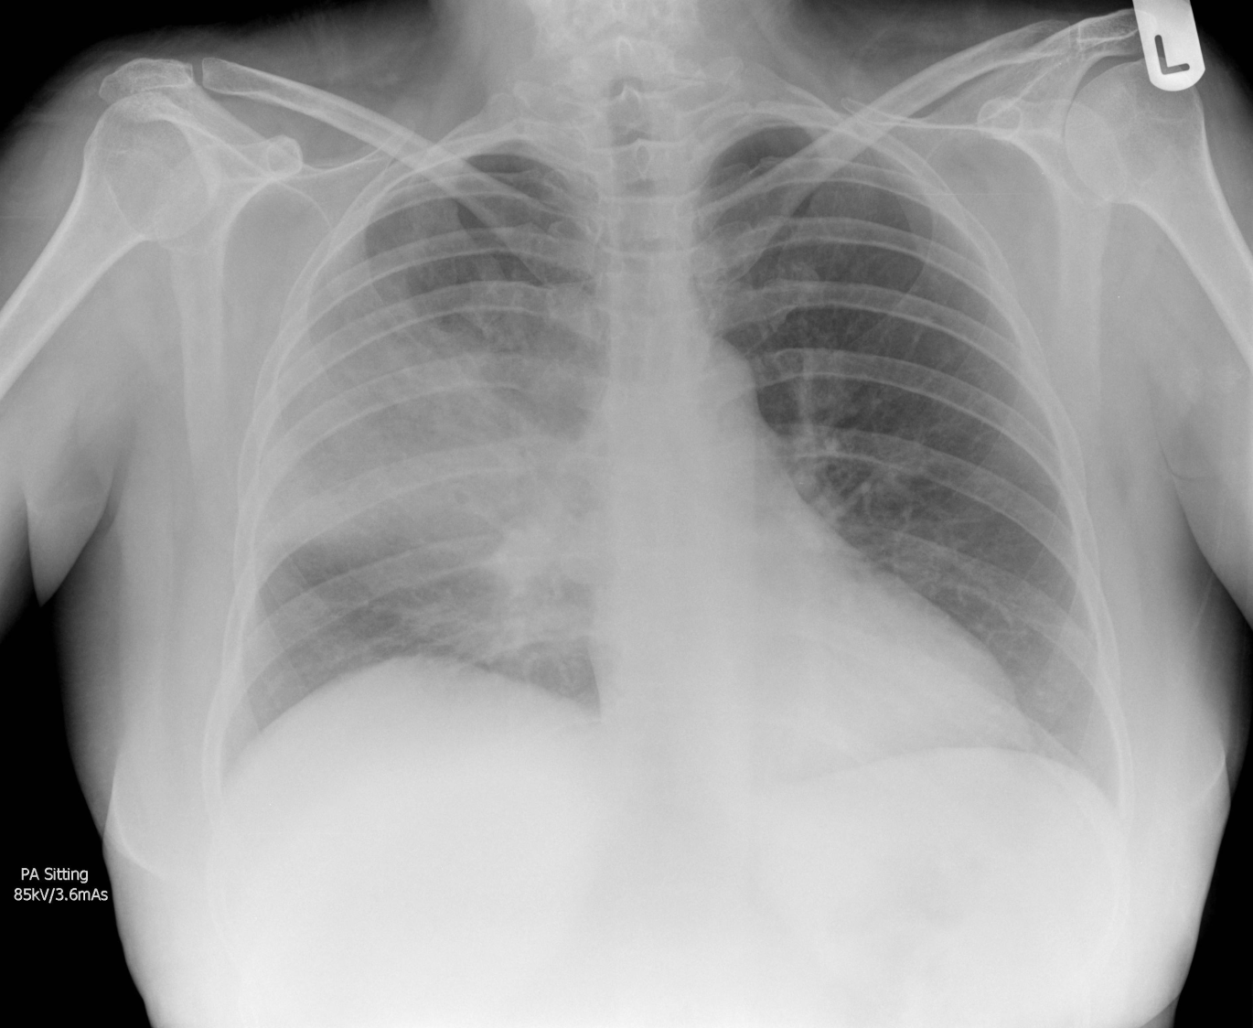
Questions?
Randomized, Embedded, Multifactorial, Adaptive Platform
For Community-Acquired Pneumonia

