Slide 1
Corticosteroid Domain

Slide 2
Background: Corticosteroids
There is significant uncertainty regarding the use of corticosteroids in patients with severe CAP (other than CAP caused by COVID-19) requiring hospital admission
Several RCTs and meta-analyses have suggested benefit of treatment with corticosteroids, however existing evidence is not definitive and corticosteroids have a range of potentially adverse effects
Potential benefit appears to be more likely for patients who are severely ill

Slide 3
Background: Corticosteroids
Uncertainty about the use of corticosteroids in:
Patients with CAP due to influenza
Patients with septic shock vs those without septic shock
Patients with ARDS vs no ARDS.

Slide 4
Changes to Corticosteroid Domain
Major changes to the Corticosteroid Domain in V5:
Addition of new intervention, fixed course dexamethasone
Domain now available in Moderate State (i.e. patients who are not receiving organ failure support in an ICU)
Only where updated Core Protocol has been approved.
Domain now available to children aged ≥ 28 days
Only where updated Core Protocol has been approved.

Slide 5
Eligibility
Inclusion Criteria:
Aged ≥28 days old
If in the Moderate State, receiving some form of supplemental oxygen
Simple facemask, low- or high-flow oxygen, or non-invasive ventilation

Slide 6
Eligibility
Exclusion Criteria:
Known hypersensitivity to any corticosteroid
Intention to prescribe systemic corticosteroids for a reason that is unrelated to the current episode of CAP (or direct complications of CAP)
More than 24h have elapsed since ICU admission (if in the Severe State)
The treating clinician believes that participation in this domain is not in the best interests of the patient

Slide 7
Corticosteroid Domain Interventions
No corticosteroids
Fixed duration hydrocortisone (IV hydrocortisone, 50 mg 6 hourly for 7 days)
Shock-dependent hydrocortisone
(IV hydrocortisone, 50 milligrams every 6 hours while patient is in shock)
Fixed duration dexamethasone (IV or enteral dexamethasone 6mg daily for 10 days)

Slide 8
No corticosteroid intervention
Do not prescribe any systemic corticosteroid, including hydrocortisone or dexamethasone
Withholding of corticosteroids is to continue until day 28 or hospital discharge (whichever occurs first)
Administration of systemic corticosteroids for the treatment of new illnesses that develop in the course of a patient’s ICU stay (i.e. not resulting from CAP or its direct complications) is permitted

Slide 9
Fixed-dose hydrocortisone
Prescribe hydrocortisone IV 50 mg 6 hourly for 7 days
It is intended that a course of 28 doses is administered
Commence immediately after randomisation
Cease after 7 days or hospital discharge, whichever occurs first
Prescribe to continue on ward if discharged from ICU before 7 days (not a protocol violation if ceased by ward staff)

Slide 10
Shock-dependent hydrocortisone
Commence hydrocortisone IV 50 mg 6 hourly when patient is in septic shock
Septic shock defined as:
Administration of any vasopressor by continuous infusion
The treating clinician believes the vasopressor requirement is due to the CAP and not another reason (e.g. hypovolaemia, sedation, mechanical ventilation)
If septic shock is present at time of enrolment commence immediately
Cease once clinician believes septic shock is resolved.
Note that septic shock is always considered to be resolved when vasopressors have not been administered via infusion in the preceding 24 h

Slide 11
Fixed-dose dexamethasone
Prescribe dexamethasone (IV or enteral) 6mg daily for 10 days
Commence immediately after randomisation
In pregnancy, dexamethasone should be replaced by oral prednisolone 40mg once daily, or IV hydrocortisone 50mg 6 hourly
In children, administer dexamethasone 0.15 mg/kg (max 6mg/day)
Cease after 10 days or hospital discharge, whichever occurs first
If patient develops septic shock, a switch from dexamethasone to hydrocortisone is permitted.

Slide 12
End-point
Primary endpoint
REMAP-CAP primary endpoint, as defined in Core Protocol

Slide 13
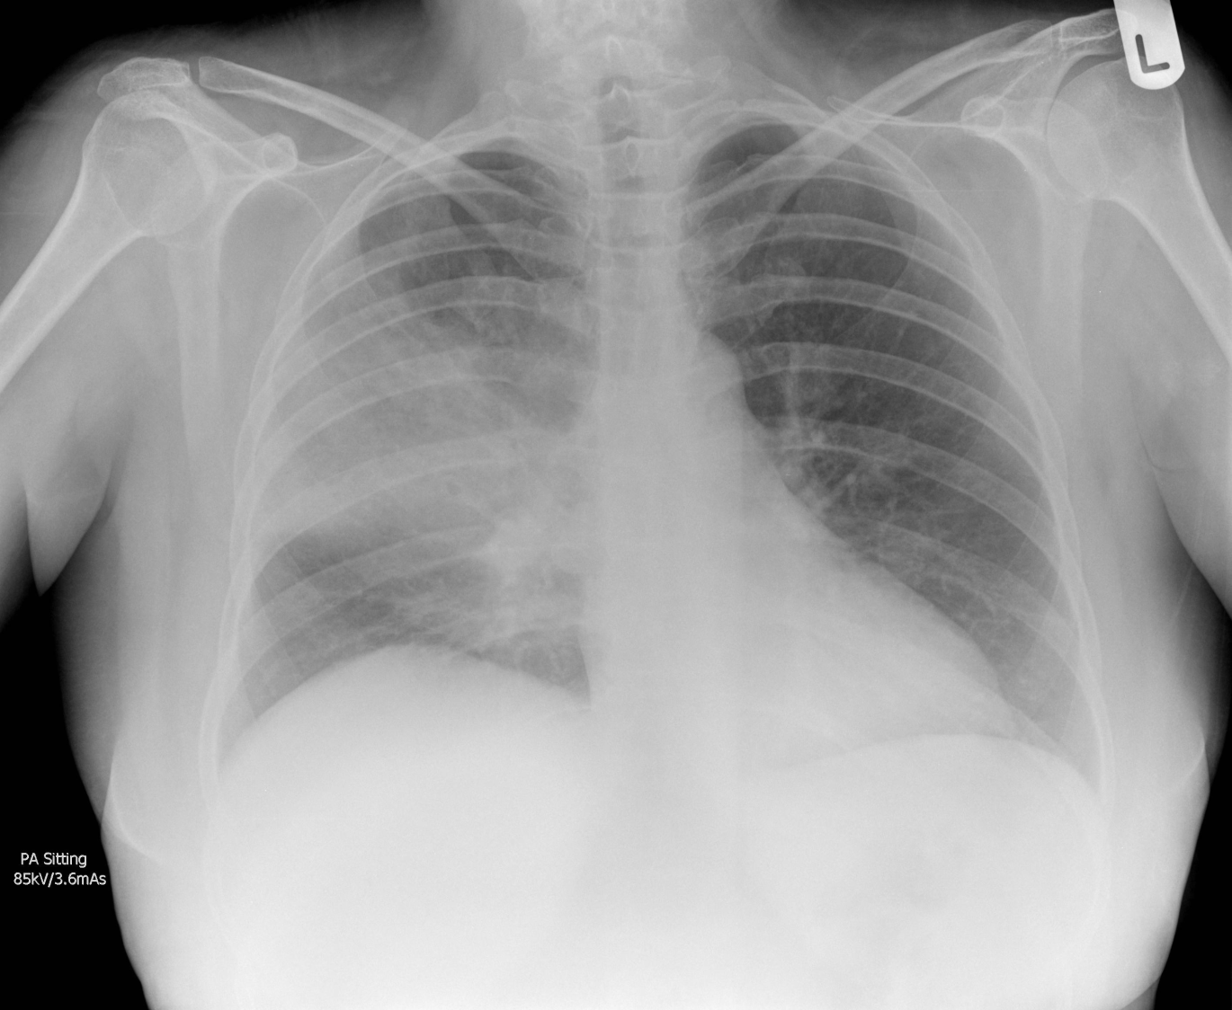
Questions?
Randomized, Embedded, Multifactorial, Adaptive Platform
For Community-Acquired Pneumonia

