Slide 1
Macrolide Duration Domain

Slide 2
Background: Macrolide Duration
International guidelines for the empiric treatment of severe CAP recommend treatment with either a macrolide or fluoroquinolone to provide antimicrobial treatment for atypical respiratory pathogens.
IDSA guidelines recommend administration of azithromycin for between 3 and 5 days, but other guidelines do not provide any recommendation regarding duration of macrolide antibiotics
A majority of ANZ ICU specialists indicated that over half cease azithromycin after 3 days if there is not microbiological evidence of atypical organisms

Slide 3
Background: Macrolide Duration
Azithromycin has well-described immunomodulatory effects, including inhibiting production of inflammatory cytokines and neutrophils.
The clinical manifestation of pneumonia is the interaction between an infective pathogen and the local and systemic inflammatory responses of the host.
A more pronounced inflammatory response of the host has been associated with treatment failure and increased mortality
The immunomodulatory properties of macrolides provide a rationale for why an extended course may be superior to a shorter standard course of 3-5 days.

Slide 4
Macrolide Domain Interventions
Standard course macrolide discontinued after 3 - 5 days
Extended course macrolide prescribed for 14 days or hospital discharge, whichever occurs first

Slide 5
Eligibility
Inclusion criteria:
Randomised to receive a beta-lactam + macrolide intervention in the Antibiotic Domain

Slide 6
Eligibility
Reveal of allocation status is not permitted if:
Study day 6 has commenced
Agreement to participate in this domain has not been obtained
There is microbiological confirmation or the clinician strongly suspects Legionella or any other form of atypical pneumonia
Macrolide antibiotics have already been discontinued for more than 36 hours
Treating clinician believes that participation is not in the patient’s best interests

Slide 7
Interventions
Choice of Macrolide and route of administration
Initial IV administration preferred
Preferred IV macrolide is azithromycin, but IV clarithromycin can be substituted
Preferred enteral macrolide is azithromycin, but enteral clarithromycin or roxithromycin can be substituted
IV to enteral switch can occur when clinically appropriate, at least 2 does of IV macrolide recommended
Erythromycin is not eligible for macrolide duration domain

Slide 8
Interventions
Dose:
Dose and frequency at discretion of treating clinician
Protocol provides recommended doses
IV and enteral doses the same
No adjustment for renal function or renal replacement therapy needed

Slide 9
Workflow
Patient randomised to a beta-lactam + macrolide intervention in Antibiotic Domain
Commence macrolide as part of allocated intervention in Antibiotic Domain (database will indicate the site preferred macrolide)
Prescribe a minimum of three days of macrolide therapy

Slide 10
Workflow
Reveal allocation status for Macrolide Duration Domain
Update the database with the following before the end of Study Day 5
Consent / agreement from the patient and/or person responsible
Whether macrolide has been ceased for more than 36h since randomisation
Results of legionella or other atypical pneumonia
Whether clinician believes that participation is in the patient’s best interests
Once the above entered the Domain’s Allocation Status will be displayed if the patient is eligible

Slide 11
Workflow
Prescribe allocated intervention:
Standard Duration
If revealed prior to study day 3: continue macrolide until study day 3
If revealed on or after study day 3: Stop macrolide immediately
Extended Duration
Prescribe macrolide to complete 14 day course
IV to enteral switch permitted
Prescribe to continue on ward if discharged from ICU before 14 days (not a protocol violation if ceased by ward staff)

Slide 12
Interventions
Early Discontinuation of Macrolide:
Cease if patient experiences SAE thought to be related to macrolide (e.g. ventricular tachycardia)
Consider QT interval at time of cessation of continuous ECG monitoring

Slide 13
Concomitant Care
Low dose erythromycin (for gastric emptying) is permitted (but discouraged)
Duration of macrolide therapy not affected by macrolide susceptibility of infecting organism

Slide 14
End-point
Primary endpoint
All-cause mortality at day 90
Days alive and not receiving organ support in ICU at day 21 (patients with pandemic infection).

Slide 15
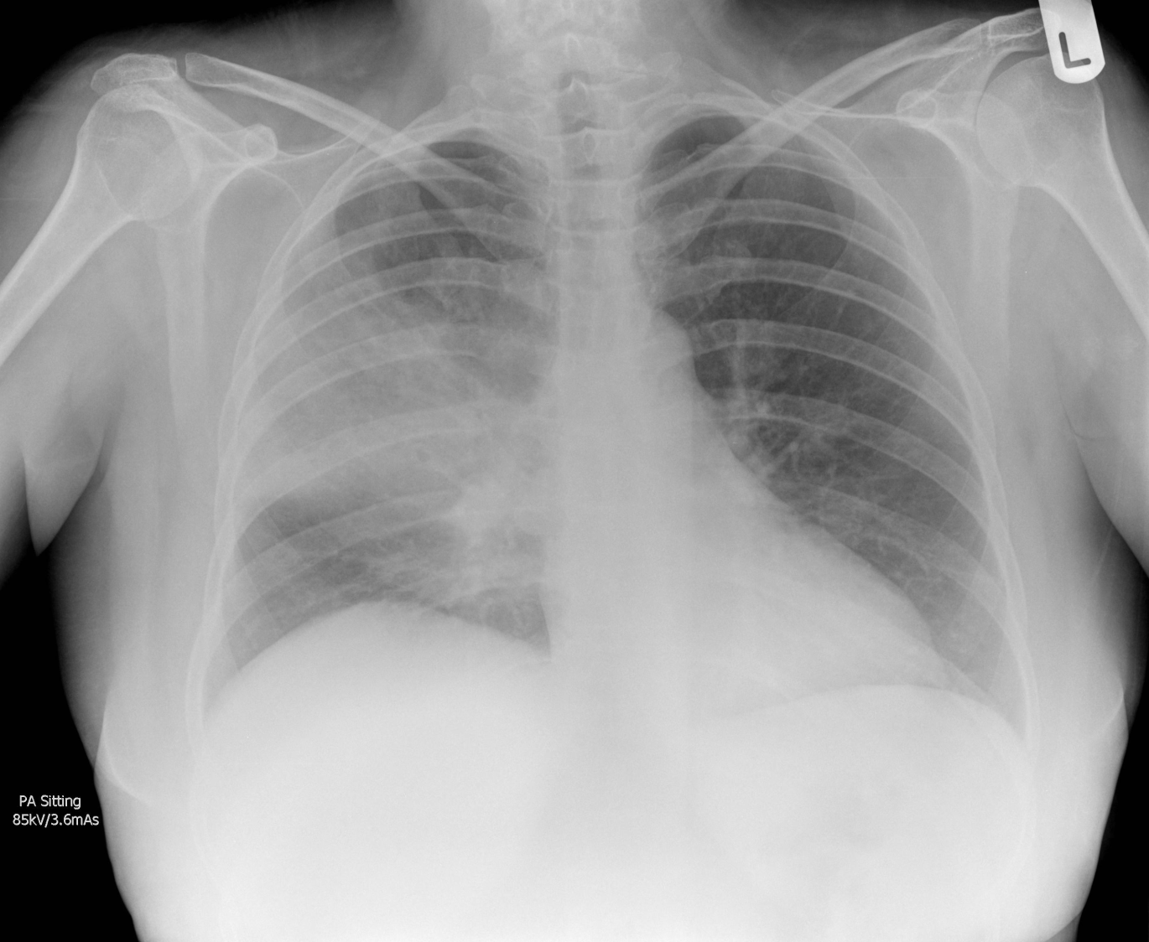
Questions?
Randomized, Embedded, Multifactorial, Adaptive Platform
For Community-Acquired Pneumonia

