Slide 1
Pandemic Stratum

Slide 2
Pandemic Appendix to Core Protocol
Pandemic strata designed as a sleeping strata
Activated by the REMAP-CAP trial steering committee 13 March 2020
Activation of Pandemic Strata results in a number of changes to:
Eligibility criteria
Primary end-point
Statistical model
Frequency of RAR
New pandemic-specific domains

Slide 3
Changes to eligibility
Does the patient have clinically suspected or proven pandemic infection
Clinically suspected = treating clinician believes that pandemic infection is a likely diagnosis
That testing is being done is not sufficient, must think pandemic infection is likely
Response to this question drives a number of changes to eligibility, CRF, randomization, and primary end-point.
Suspected or proven hospital-acquired pandemic infection are eligible

Slide 4
Changes to eligibility
The following platform eligibility criteria do not apply for patients with clinically suspected or proven pandemic infection:
Is the patient a resident of a nursing home or long-term care facility
Prior to this illness was the patient known to be an inpatient in any healthcare facility within the last 30 days
Does the patient have signs and/or symptoms that are consistent with lower respiratory tract infection
Does the patient have radiological evidence of new onset infiltrate of infective origin
Time window from hospital admission to ICU admission
Questions are still asked, software processes responses

Slide 5
Changes to eligibility
Platform inclusion criteria:
Adult patient admitted to hospital with acute illness due to suspected or proven pandemic infection
Platform exclusion criteria:
Death deemed imminent within next 24 hours
Patient expected to be discharged from hospital today or tomorrow
>14 days have elapsed while admitted to hospital with symptoms of acute illness due to suspected/proven pandemic infection
Previous participation in this REMAP within the last 90 days

Slide 6
Changes to eligibility
Patients may now be eligible in both Moderate and Severe disease states:
Severe State = receiving organ support in ICU
Moderate State =
In ICU but not receiving organ support
Not in ICU
Patients may receive allocations while in Moderate state and later receive an allocation to other domains if then progress to Severe state.
Patients in Severe state cannot receive additional allocations if they become Moderate.

Slide 7
Changes to eligibility
Location of the patient at time of screening
ICU or non-ICU location
Whether the patient has received invasive mechanical ventilation in ICU during this acute hospital admission
For patients being assessed for Moderate State
Where was pandemic infection acquired
In hospital or in the community
If in hospital, have signs or symptoms of pandemic infection been present for less than 14 days
Ability to receive allocations in additional domains for Moderate patients who transition to the Severe state

Slide 8
Changed definitions
ICU
During a pandemic an ICU is defined as an area that is capable of providing ICU-level care:
NIV with a sealed mask, invasive mechanical ventilation, or vasopressors via continuous infusion
Existing wards which provide sealed mask NIV which do not have expanded capabilities do not qualify
May be a physical ICU or an area not usually designated as an ICU which has been re-purposed

Slide 9
Changed definitions
ICU Admission
For patients admitted to a location that is not usually designated as an ICU, admission is the time of first administration of qualifying organ support
Mechanical ventilation
Non-invasive ventilation (including HFNO)
Vasopressors or inotropes via continuous infusion
If the patient is not in a physical ICU, do not commence the eligibility process until patient has a qualifying organ failure support

Slide 10
Changed definitions
ICU Discharge
For patients admitted to a location that is not usually designated as an ICU, discharge is the time at which a patient leaves an area that is able to provide ICU level care
Time and date of first and last organ support also documented
Mechanical ventilation
Non-invasive ventilation
Continuous infusion of vasopressor or inotropes
HFNP with FiO2 ≥ 0.4
ECMO

Slide 11
Primary end-point
Days alive and not receiving organ support in ICU at Day 21
Censored at hospital discharge (no need to follow-up after hospital discharge until usual D90)
It is VITAL that D21 endpoint is entered as soon as possible after the end of study day 21
D90 follow up still required
D180 follow up not required for patients with suspected or proven pandemic infection

Slide 12
CRF changes
Baseline
Whether the patient is a healthcare worker who has had direct contact with patients with suspected/confirmed COVID-19 within the last 21 days.
Whether the patient is in a physical ICU or area not usually designated as an ICU at eligibility
Additional physiological measurements
Micro CRF
Results of microbiological testing for SARS-CoV-2 (during this acute respiratory illness, up until 72 hours after eligibility)

Slide 13
CRF changes
Daily data
Location of patient on each study day (physical ICU, or area not usually designated as an ICU)
Corticosteroid administration for all patients with suspected or proven infection
Medication administration
Updated to collect administration of antiviral and immunomodulatory agents that may be active against SARS-CoV-2

Slide 14
CRF changes
Discharge
Date and time of first and last organ support in ICU
Co-enrolment in another study (study name, participant ID, and allocation if known)
Day 21
Date and time of ICU discharge and any ICU readmissions prior to day 21
Hospital discharge date and status (prior to day 21)

Slide 15
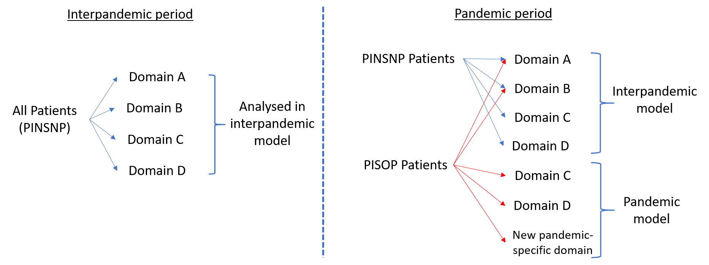
Statistical Model
Domains considered relevant to the pandemic are analyzed using a separate statistical model
RAR occurs separately for patients with and without pandemic infection
PISOP patients = Pandemic Infection Suspected or Proven
PINSNP patients = Pandemic Infection Neither Suspected Nor Proven

Slide 16
Analysis and RAR during pandemic
Statistical model evaluates all pandemic domains
Evaluates patients who are confirmed COVID-19 and not confirmed COVID-19 separately with borrowing between stratum, as appropriate
Reduction in statistical trigger from 0.99 to 0.95 probability of superiority
RAR driven off confirmed COVID-19 for future suspected and confirmed patients
Assesses safety in suspected patients who turn out to be non-COVID patients

Slide 17
Current Domains in pandemic model
Corticosteroid strategy
Sites can choose different set of interventions for pandemic and non-pandemic patients
Macrolide duration
Important given French uncontrolled case-series
Only accessible if allocated to a beta-lactam + macrolide combination in antibiotic domain
Can still get assignment for antibiotics and influenza antiviral, analyzed in non-pandemic statistical model

Slide 18
COVID-19 Specific Domains
COVID-19 Antiviral Domain
No antiviral for COVID-19 (no placebo)
Lopinavir/ritonavir (“Kaletra”)
Hydroxychloroquine
COVID-19 Immune Modulation Domain
No immune modulation for COVID-19 (no placebo)
Interferon-β-1a
Anakinra (Interleukin-1 receptor antagonist)
Tocilizumab
Sarilumab

Slide 19
COVID-19 Specific Domains
Therapeutic anticoagulation
Local standard thromboprophylaxis
Therapeutic anticoagulation with LMWH or UFH
Immunoglobulin
No immunoglobulin intended to neutralize COVID-19
Convalescent plasma for COVID-19
Simvastatin
No simvastatin
Simvastatin

Slide 20
COVID-19 Collaboration
Coordinating with other studies for COVID-19
ASCOT trial in ANZ (antivirals)
CATCO in Canada (antivirals)
Possible randomisation in REMAP-CAP antiviral domain if in control arm of ASCOT / CATCO
LOVIT trial (vitamin C)
ATTACC trial (therapeutic anticoagulation)

Slide 21
Consent processes during pandemic
Have requested permission to use phone / electronic confirmation of agreement to participate from person responsible
Considering asking for permission to allow verbal consent from participant if competent to consent

Slide 22
Role of DSMB
Granted more flexibility
Can ask for additional analyses that might be relevant
Permitted to contact public health authorities direct with any information that they believe is important to public health response to COVID-19

Slide 23
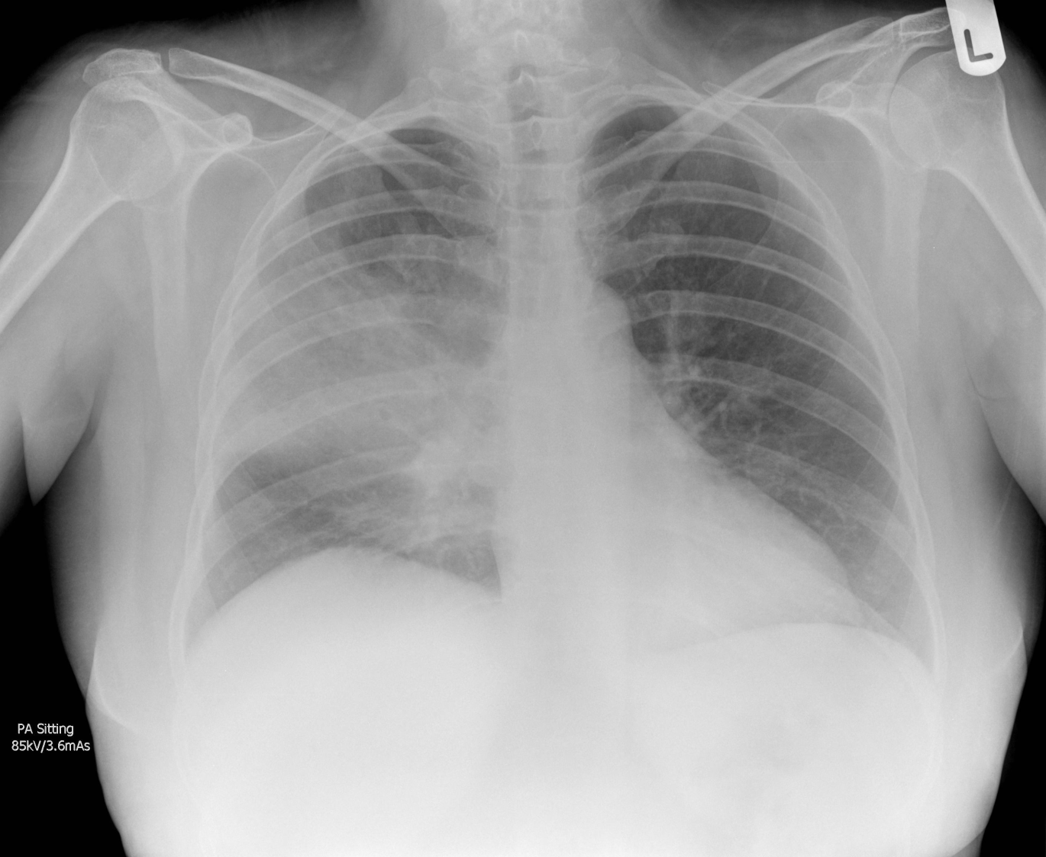
Questions?
Randomized, Embedded, Multifactorial, Adaptive Platform
For Community-Acquired Pneumonia

