Slide 1
Influenza Immune Modulation Domain
(IM Flu)

Slide 2
Influenza IM Background
Immune modulation with tocilizumab and baricitinib is effective in severe COVID-19
There are similarities in the immune response in severe COVID-19 and severe influenza
Interleukin-6 (IL-6) is a key cytokine and levels are elevated in both severe COVID-19 and severe influenza
In influenza:
High IL-6 concentrations were associated with disease severity and mortality and inversely associated with arterial oxygen levels in hospitalized influenza patients

Slide 3
Influenza IM Domain Interventions
Available interventions:
No Immune Modulation
Tocilizumab
Baricitinib

Slide 4
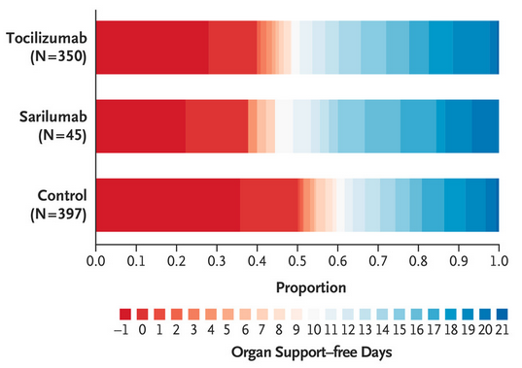
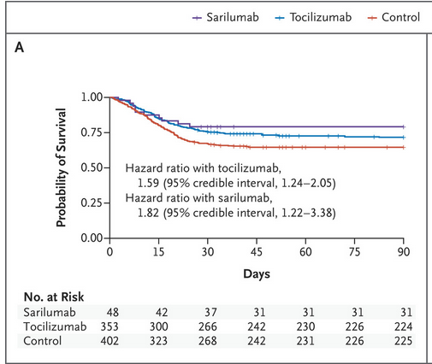
Background: Tocilizumab
Interleukin-6 receptor antagonist
Licensed for use in rheumatological conditions and for COVID-19
Studied in REMAP-CAP (‘IM1’ COVID-19 Immune Modulation Domain) alongside another IL-6RA sarilumab

Slide 5
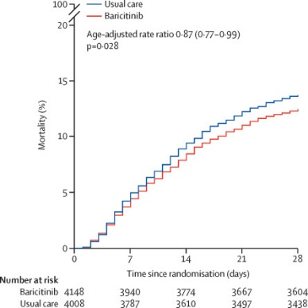
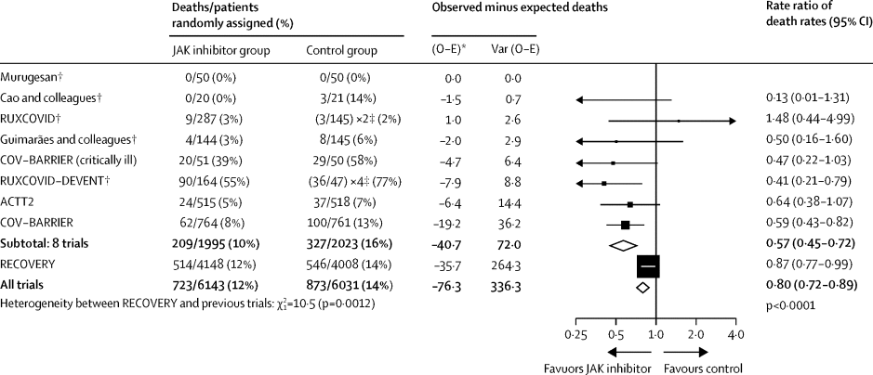
Background: Baricitinib
Oral/enteral selective JAK1/JAK2 inhibitor
Widely used for autoimmune and atopic diseases
Inhibits the intracellular signaling of cytokines known to be elevated in severe influenza (including IL-6)
Effective in severe COVID-19

Slide 6
Key study question in Influenza IM
Does treatment with tocilizumab or baricitinib, improve outcomes for critically ill adults with severe influenza?

Slide 7
Eligibility
Inclusion Criteria:
Platform eligible
Severe state (receiving organ failure support)
Influenza virus infection confirmed by microbiological testing.
In the opinion of the treating clinician, the primary contributor to the patient’s Severe Illness is a respiratory tract infection (e.g. not unwell with trauma and happen to have influenza)

Slide 8
Eligibility
Domain Exclusion Criteria:
SARS-CoV-2 infection has been confirmed by microbiological testing
Known condition or treatment resulting in ongoing immune suppression including neutropenia prior to this hospitalization
A neutrophil count <1.0 x 10⁹ / L
Confirmed or strongly-suspected active mycobacterial infection or invasive fungal infection
Patient has already received any dose of one or more of tocilizumab (or another IL-6 receptor antagonist) or baricitinib (or another JAK inhibitor) during this hospitalization or is on long-term therapy with any of these agents prior to this hospital admission.
The treating clinician believes that participation in the domain would not be in the best interests of the patient

Slide 9
Eligibility
Intervention Exclusion Criteria:
Known hypersensitivity to an agent specified as an intervention in this domain will exclude a patient from receiving that agent.
Known or suspected pregnancy is an exclusion for Baricitinib.
Whether known or suspected pregnancy results in exclusion from the tocilizumab intervention depends on local approvals
An ALT or an AST that is >5x the upper limit of normal is an exclusion for tocilizumab
A platelet count < 50 x 10⁹ / L is an exclusion for tocilizumab
A baseline eGFR <15 mL/min/1.73m² and/or receipt of renal replacement therapy (including long-term renal replacement therapy) at baseline is an exclusion from Baricitinib

Slide 10
Randomization with delayed reveal
In patients with influenza test results pending, can randomize with ‘Delayed Reveal’ when test results are available.

Slide 11
No Influenza Immune Modulation Intervention
Patients assigned to this intervention are not to receive any additional targeted immune modulation therapy until the end of study day 28
Corticosteroids can be administered, either by enrolment in the Corticosteroid Domain of REMAP-CAP or as determined by the treating clinician

Slide 12
Tocilizumab intervention
Adult dosing:
Tocilizumab will be administered as a single dose of 8mg/kg based with the total dose not exceeding 800mg
Given as an infusion via a central or peripheral line over a one-hour period

Slide 13
Tocilizumab intervention
Pediatric dosing:
For children weighing ≥30kg adult dosing will be used (single dose of 8mg/kg based with the total dose not exceeding 800mg)
For children weighing < 30 kg tocilizumab will be administered as a single dose of 12mg/kg
Given as an infusion via a central or peripheral line over a one-hour period

Slide 14
Baricitinib Intervention
Adult dosing:
Baricitinib will be administered enterally at a dose of:
4 mg once daily if the eGFR is ≥60
2 mg once daily if the eGFR is ≥30 and <60
1 mg once daily if the eGFR is ≥15 and <30
Dose withheld if the eGFR is <15 mL/min or if the patient is receiving renal replacement therapy
Cease baricitinib after 10 days or hospital discharge, whichever occurs first

Slide 15
Baricitinib Intervention
Pediatric (≥ 9 years) dosing:
Baricitinib will be administered enterally at a dose of:
4 mg once daily if the eGFR is ≥60
2 mg once daily if the eGFR is ≥30 and <60
1 mg once daily if the eGFR is ≥15 and <30
Dose withheld if the eGFR is <15 mL/min or if the patient is receiving renal replacement therapy
Cease baricitinib after 10 days or hospital discharge, whichever occurs first

Slide 16
Baricitinib Intervention
Pediatric (< 9 years) dosing:
Baricitinib will be administered enterally at a dose of:
2 mg once daily if the eGFR is ≥60
1 mg once daily if the eGFR is ≥30 and <60
Dose withheld if the eGFR is <30 mL/min or if the patient is receiving renal replacement therapy
Cease baricitinib after 10 days or hospital discharge, whichever occurs first

Slide 17
Influenza IM Drugs
Use hospital stock of tocilizumab and baricitinib
We are working with suppliers to investigate whether tocilizumab may be made available to participating sites

Slide 18
Influenza Immune Modulation Endpoints
Primary endpoint
The primary endpoint for this domain is the primary outcome specified in the version of the REMAP-CAP Core Protocol that is operative at the time of each adaptive analysis.

Slide 19
Influenza Immune Modulation Endpoints
Secondary endpoints
As per core protocol with the following additional domain-specific secondary endpoints:
Positive blood culture for pathogenic bacteria and/or fungus during this hospitalization and more than 48 hours following randomization
Pulmonary aspergillosis, during this hospitalization and more than 48 hours following randomization

Slide 20
Domain specific adverse events
Severe thrombocytopenia, out of keeping with clinical disease
Severe neutropenia, out of keeping with clinical disease
Increase in LFTs to 5x upper limit of normal
Gastrointestinal perforation
SAEs in the opinion of the site investigator reasonably have occurred as a consequence of study intervention or study participation

Slide 21
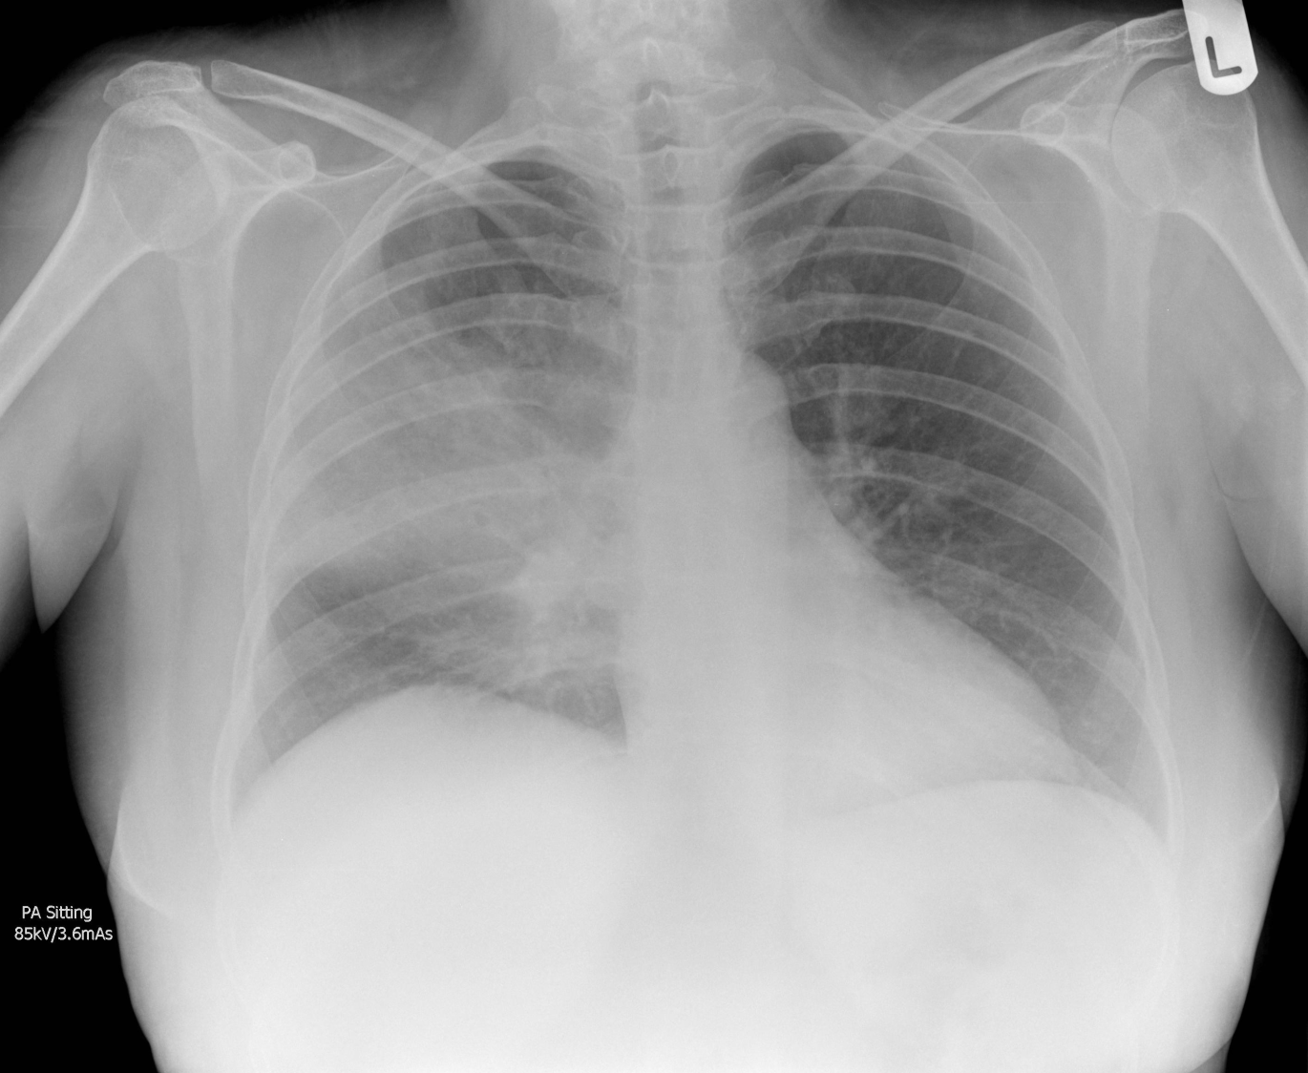
Questions?
Randomized, Embedded, Multifactorial, Adaptive Platform
For Community-Acquired Pneumonia

