Slide 1
REMAP-CAP
Randomized, Embedded Multifactorial Adaptive Platform trial for Community-Acquired Pneumonia
Consent Case Report Form
16th July 2024

Slide 2
Updates to the REMAP-CAP Consent CRF

Slide 3
Consent Case Report Form
We have undertaken a thorough review of the REMAP-CAP CRF, and are in the process of updating both the eligibility module and eCRF.
A number of limitations of the existing Consent CRF have been raised by various stakeholders, and this has led to a complete redesign of the Consent CRF.
Updates to this form have been prioritised ahead of changes to other forms in the eCRF

Slide 4
Consent Case Report Form
These changes aim to:
More clearly document a range of consent discussions and scenarios
Accommodate region-specific consent requirements
More easily identify situations where appropriate consent may not have not been obtained
Avoid unnecessary or ambiguous questions
The updated Consent CRF will apply to all participants randomised after 18th July, 2024. No changes are required for existing participants.

Slide 5
Completing the Consent CRF

Slide 6
General guidance
Enter all consent discussions that have occurred, including those with no decision / outcome
Contact your regional coordinating centre if you are unsure how a particular question should be answered.
If consent is not obtained in writing from the participant, you will be asked to provide a reason why it has not.
It is recognised that, while every attempt will be made to obtain consent in writing from the participant, this may not be possible or necessary in every instance.

Slide 7
To add a consent discussion / event, navigate to the participant’s Consent CRF and click ‘add discussion’.
Each consent discussion or event should be added separately.

Slide 8
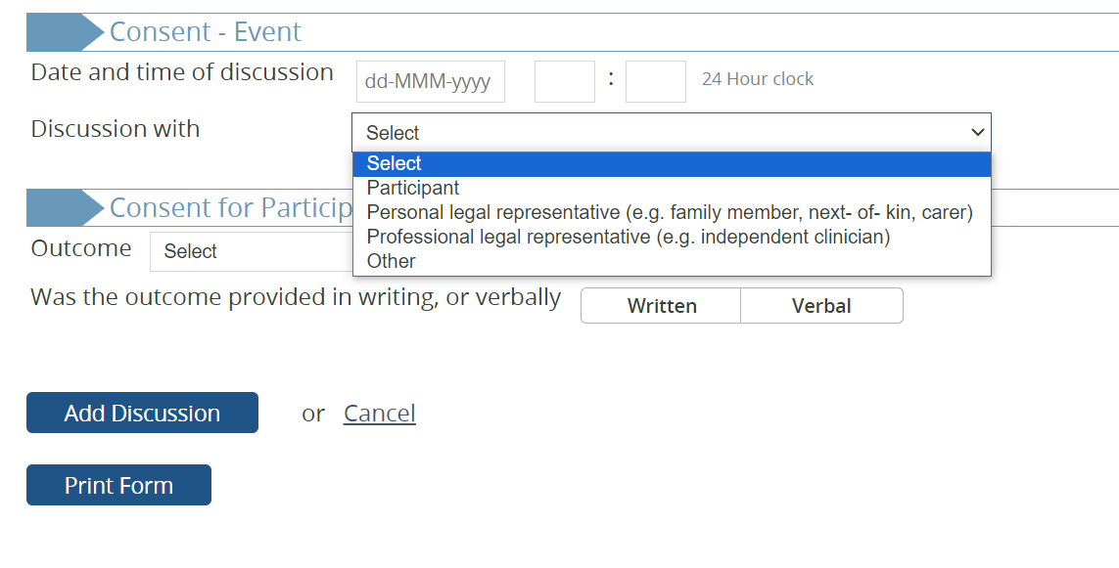
Enter the date and time of the discussion, and who the discussion was with.
Note that ‘professional legal representative’ will only appear if this is permitted in your region.
If ‘other’ is selected, you will be asked to specify who the discussion was with. Enter the relationship of the individual to the participant, or their position. Do not enter the name of the individual.
If more than one individual was present during the discussion, select the individual who provided the decision (either to agree to or decline participation) in writing or verbally.
If no decision was made at the time of the discussion, select participant if the participant was actively involved in the discussion.

Slide 9
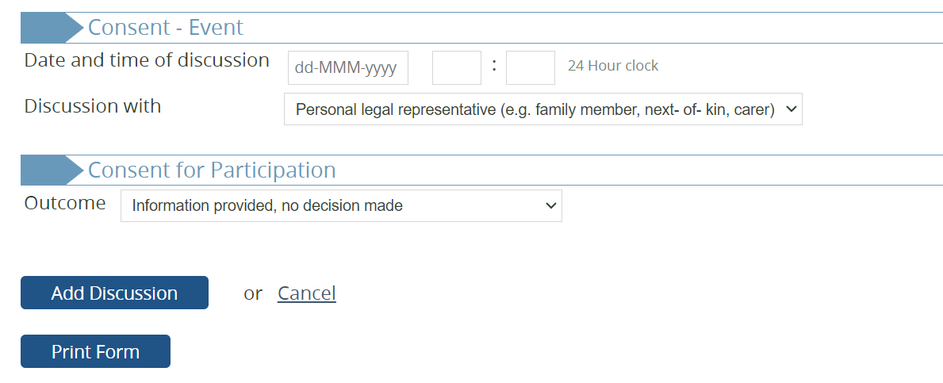
Select the outcome of the discussion.
If no decision was made (e.g. if the participant or their proxy wanted more time to consider participation) select ‘information provided, no decision made’. Then click ‘add discussion’ to save the event.
If / when a decision has been made, this should be entered as a separate event.

Slide 10
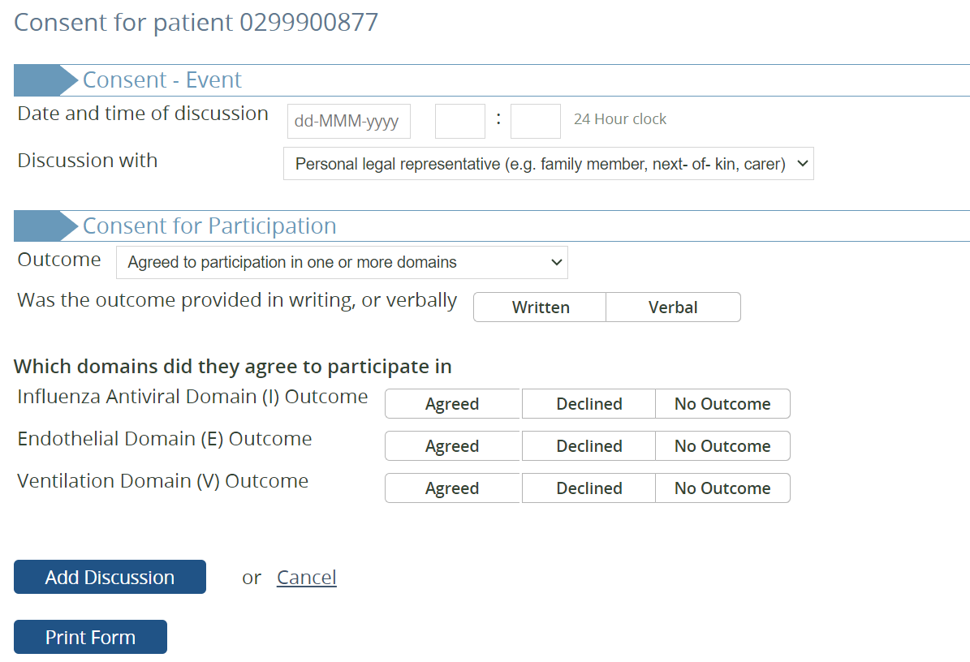
Select the outcome of the discussion.
If the participant or an appropriate proxy has agreed to participate in at least one domain, select ‘agreed to participation in one or more domains’.
You will be asked whether their agreement to participate was provided in writing, or only communicated verbally.
Indicate which domains the participant or their proxy has agreed to.
A participant or their proxy may agree to participate in one or more domains, while declining participation in others. In some cases, they may also make a decision about some domains, while requiring more time to consider participation in others.

Slide 11
Agreement for domain participation
Participants or their proxies may choose to agree or decline participation in each domain for which they have received an allocation.
This decision relates to participation in the domain, and is distinct from agreement to the use of their data (covered on following slides).
You are able to select “agreed”, “declined”, or “no outcome” for each domain the participant has received an allocation in.

Slide 12
Agreement for domain participation
If the participant or their proxy declines to participate in one or more domains, their treatment with respect to any allocated interventions in those domains is a clinical decision and is at the discretion of the treating clinician.

Slide 13
Agreement for domain participation
In some cases, a participant or their proxy may agree to participate in some domains, but may require more time to consider participation in other domains
In such instances, allocated interventions should be continued as per protocol while the participant or their proxy is given the opportunity to make a decision about their participation
The treating clinician may pause or discontinue an allocated intervention at any time, if they believe that doing so is in the best interests of the participant.

Slide 14
Agreement for domain participation
Complete a separate entry for each consent discussion.
If there is ‘no outcome’ for one or more domains, save the entry and complete a new entry if / when the participant or their proxy has made a decision about their participation in those domains.
You will also be asked to confirm any previous decisions to agree to or decline participation in all other domains.

Slide 15
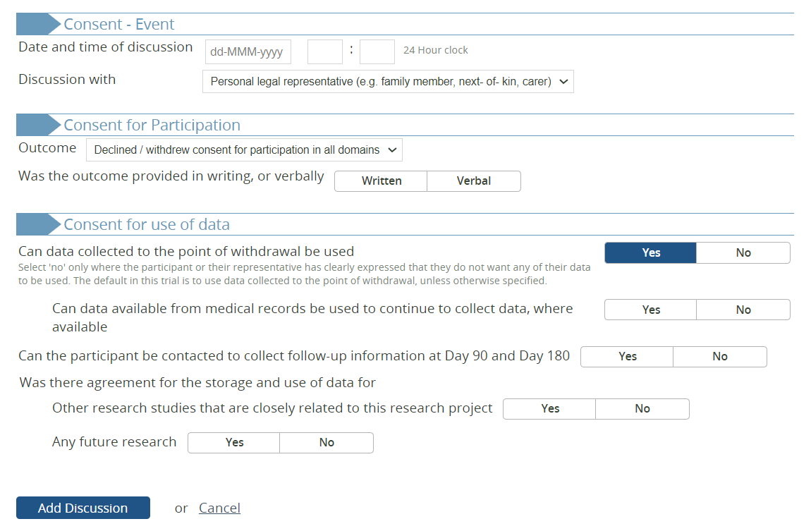
Select the outcome of the discussion.
If the participant or an appropriate proxy has declined to participate in all domains, select ‘declined / withdrew consent for participation in all domains’.
You will then be asked to confirm consent for the use of the participant’s data.
Note that the default in REMAP-CAP is to use all data collected to the point of withdrawal. Select ‘no’ only if the participant or their proxy has explicitly stated that they do not want their data to be used.
If the participant or proxy agree to the use of data already collected, they may also chose whether or not to agree to the continued collection of data from existing medical records, and whether or not they would like to be contacted to participate in long-term follow-up.
In some regions, participants may be asked whether their data can be used for future research. These questions will not appear in all regions.

Slide 16
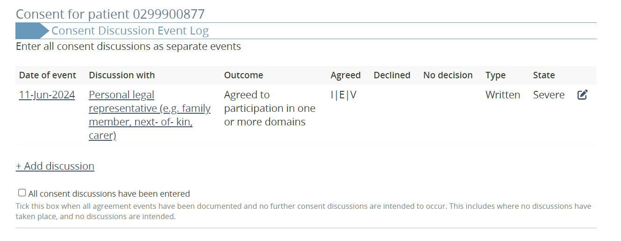
Once the details of the event have been entered and saved, you will be taken back to the Consent CRF landing page which displays a table summarising all consent discussions / events for the participant.
To add another discussion / event, click ‘add discussion’.
Once all consent discussions / events have been entered and no further discussions are intended, tick this box to mark the record as complete. This may include situations where no discussions have taken place and there is no intention to have any such discussions in future.
If any further discussions do occur, you can still come back and add these events as required.

Slide 17
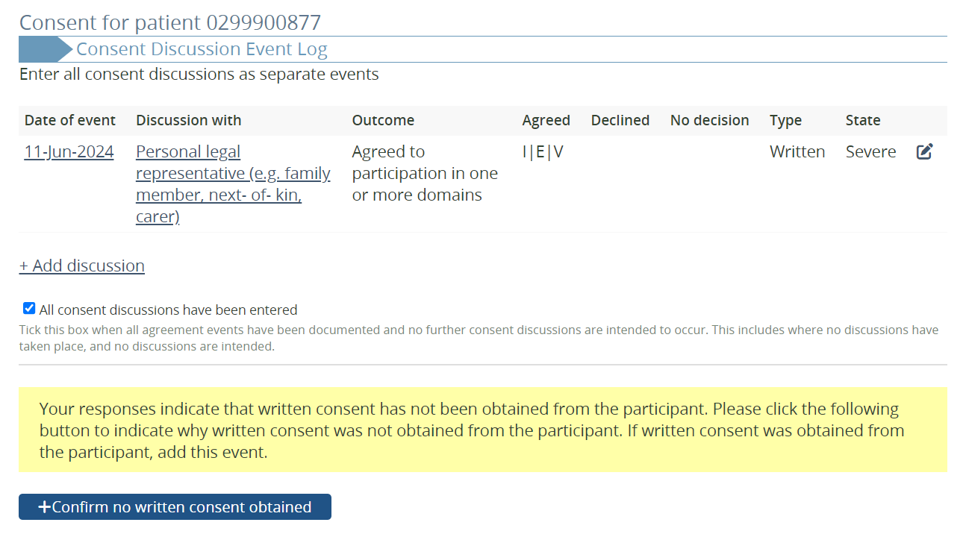
If you have entered all consent discussions, and there is no record of consent being obtained in writing from the participant, you will see the highlighted message.
If this is not correct, add or update any consent events as necessary. If, however, no written consent was obtained from the participant (for any reason) click ‘confirm no written consent obtained’.

Slide 18
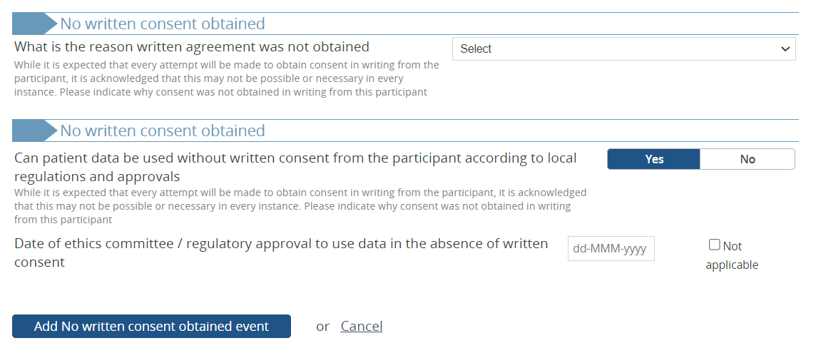
Select the reason why consent was not obtained in writing from the participant.
It is acknowledged that there may be situations where it is not possible or necessary to obtain written consent from the participant, but this question will help us to understand why it was not obtained.
Please indicate whether the participant’s data can be used in the absence of written consent from the participant according to your local regulations, and the date of approval for this (if applicable).
If you are unsure of how to answer this, or have any questions, please contact your Regional Coordinators for assistance.

