Slide 1







REMAP-CAP
Confirming Eligibility Training
V1.1, 18-DEC-2024
Chief Investigator: Prof Anthony Gordon
Study Coordination Centre:
Intensive Care National Audit & Research Centre
IRAS ID: 237150
REC ref: 18/LO/0660
Sponsor: Imperial College London
Funder: NIHR
IRAS ID: 237150
REC ref: 18/LO/0660

Slide 2

Coordinating Centre / Trial Management Team
Trial coordinated by Imperial College London
Chief Investigator: Prof Anthony Gordon
Trial Managers and Monitors: Janis Best-Lane and Aisha Anjum, Elizabeth Fagbodun, Lucy Stronach, Beren Barklam, Tina Reetun, Walton Charles and Lindsay Jack.
  Email: ukremap-cap@icnarc.org
Address:
Room 1064, 10th Floor, QEQM
St Mary’s Hospital
1 Praed Street
London
W2 1NY

Slide 3
Introduction to REMAP-CAP
A Randomised, Embedded, Multi-factorial, Adaptive Platform trial for Community-Acquired Pneumonia.
REMAP-CAP is currently open in ICUs and wards testing treatments for COVID-19, CAP and Influenza.
Adults and children admitted to hospital acutely unwell with confirmed influenza will be recruited to the trial.

Slide 4
Current open domains and stratum
ICU
- Antibiotics
Wards
- Corticosteroid
Paediatrics
-Corticosteroid
- Macrolide Duration
- Corticosteroid
- Influenza Antiviral
- Immunoglobulin
- Immune Modulation
- Influenza Antiviral
- Immunoglobulin
- Influenza Antiviral
- Immune Modulation

Slide 5
Confirming Eligibility
As per MHRA requirements only a clinician (or a role that has prescribing rights) is able to confirm whether a patient is eligible for the trial.
The clinician confirming eligibility is required to be listed on the delegation log and must have completed a training log for this eligibility assessors training so that the study has oversight of those who have received training and are qualified to confirm eligibility.
Eligibility should be confirmed for the trial and for specific domains. This needs to be documented in the medical records.
This can be in the form of completing an ‘eligibility statement’ template (signed/dated) or a direct entry in the patient medical records.

Slide 6
CAP/FLU platform inclusion criteria
Adult or paediatric patient (28 days or older) hospitalised with an acute illness due to a lower respiratory tract infection.

Slide 7
CAP/FLU platform exclusion criteria
More than 14 days has elapsed since admission to hospital
If receiving organ failure support in an ICU, more than 48 hours has elapsed since admission to ICU
Death is deemed to be imminent and inevitable during the next 24 hours AND one or more of the patient, substitute decision maker or attending physician are not committed to full active treatment.
Previous participation in this REMAP within the last 90 days
Expected to be discharged from this hospital admission within the next 24 hours

Slide 8
Influenza Antiviral domain
Inclusion
Influenza infection has been confirmed by microbiological testing.
Exclusion
Patient has already received two or more doses of oseltamivir or other neuraminidase inhibitors
Patient has already received one or more doses of baloxavir
Patient is already receiving, or a clinical decision has been made to commence, an antiviral active against influenza other than oseltamivir or baloxavir, or both.
The treating clinician believes that participation in the domain would not be in the best interests of the patient
If in Moderate State
More than 96 hours has elapsed since hospital admission
If in Severe state
More than 48 hours has elapsed since ICU admission, unless the patient has already been assigned a treatment in another domain in the Moderate State, in which case exclusion will occur if more than 48 hours has elapsed since commencement of sustained organ failure support in an ICU
Intervention Specific Exclusions
Known hypersensitivity to oseltamivir or baloxavir
Known or suspected pregnancy will result in exclusion from interventions that include baloxavir

Slide 9
Corticosteroid domain
Inclusion – If in moderate state
Patient is receiving some form of supplemental oxygen (simple facemask, low or high flow nasal oxygen, or non-invasive ventilation)
Exclusion
Known hypersensitivity to any corticosteroid
Intention to prescribe systemic corticosteroids for a reason that is unrelated to the current episode of CAP (or direct complications of CAP), such as chronic corticosteroid use before admission, acute severe asthma, or suspected or proven Pneumocystis jirovecii or COVID19 pneumonia
The treating clinician believes that participation in the domain would not be in the best interests of the patient
If in Severe state
More than 24 hours have elapsed since ICU admission; if the patient has already been assigned a treatment in another domain in the Moderate State, exclusion will occur if more than 24 hours has elapsed since commencement of sustained organ failure support in an ICU.

Slide 10
Immune Modulation domain (ICU only)
Inclusion
≥2 years​
Confirmed influenza ​
In the opinion of the treating clinician, the primary contributor to the patient’s Severe Illness State is a respiratory tract infection ​
Exclusion: ​
Confirmed COVID-19​
Immunosuppression ​
A neutrophil count <1.0 x 109 / L​
Confirmed or strongly-suspected active mycobacterial infection or invasive fungal infection​
Pregnancy - baricitinib (& tocilizumab-for now)​
Renal failure – baricitinib (eGFR <15ml/min/1.73m2 (or <30 if <9years) or RRT)​
Patient has already received any dose of one or more of tocilizumab (or another IL-6 receptor antagonist) or baricitinib (or another JAK inhibitor) during this hospitalization or is on long-term therapy with any of these agents prior to this hospital admission.​
The treating clinician believes that participation in the domain would not be in the best interests of the patient

Slide 11
Immunoglobulin domain (adults only)
Inclusion
SARS-CoV-2 infection is confirmed by microbiological testing
Patient has an underlying immunodeficiency or has received recent immunosuppressant therapy, corresponding to the APACHE II definitions (Knaus et al., 1985), extended to take into account equivalent forms of immunosuppressant therapy that post-date the APACHE II definitions.
Exclusion
Patient has already received treatment with any non-trial prescribed polyclonal antibody therapy (hyperimmune immunoglobulin, or convalescent plasma) intended to be active against COVID-19 during this acute illness.
The treating clinician believes that participation in the domain would not be in the best interests of the patient
Known hypersensitivity/allergy to an agent specified as an intervention in this domain will exclude a patient from receiving that agent
Known previous history of transfusion-related acute lung injury will exclude a patient from receiving high titre plasma
Known objection to receiving plasma products will exclude a patient from receiving any plasma components

Slide 12
Antibiotic domain (ICU adult only)
Inclusion
Admitted to ICU
Exclusion
Received more than 48 hours of intravenous antibiotic treatment for this index illness
More than 24 hours has elapsed since ICU admission
Known hypersensitivity to all of the study drugs in the site randomization schedule
A specific antibiotic choice is indicated, for example:
Suspected or proven concomitant infection such as meningitis
Suspected or proven infection with resistant bacteria where agents being trialled would not be expected to be active. This includes cystic fibrosis, bronchiectasis or other chronic suppurative lung disease where infection with Pseudomonas may be suspected but does not include patients with suspected methicillin-resistant staphylococcus aureus (MRSA) infection.
Febrile neutropenia or significant immunosuppression (including organ or bone marrow transplantation, human immunodeficiency virus (HIV) Infection with CD4 cell count 4 preceding weeks).
Suspected melioidosis
Specific microbiological information available to guide specific antibacterial therapy
The treating clinician believes that participation in the domain would not be in the best interests of the patient.

Slide 13
Antibiotic domain (ICU adult only) - continued
Intervention Specific Exclusions
Known non-serious hypersensitivity to penicillins will result in exclusion from receiving interventions that include piperacillin and amoxicillin
Known non-serious hypersensitivity to cephalosporins will result in exclusion from receiving interventions that include ceftriaxone and ceftaroline.
Known serious hypersensitivity to beta-lactams, including penicillins or cephalosporins, will result in exclusion from interventions that include piperacillin, amoxicillin, ceftriaxone, and ceftaroline.
Known hypersensitivity to moxifloxacin or levofloxacin will result in exclusion from moxifloxacin or levofloxacin intervention.
Known serious hypersensitivity to the macrolide will result in exclusion from interventions that include piperacillin, amoxicillin, ceftriaxone, and ceftaroline.
Known or suspected pregnancy will result in exclusion from moxifloxacin or levofloxacin and ceftaroline interventions. It is normal clinical practice that women admitted who are in an age group in which pregnancy is possible will have a pregnancy test conducted. The results of such tests will be used to determine interpretation of this exclusion criteria.

Slide 14
Macrolide domain (ICU only)
Inclusion
Patients are eligible for this domain only if they have been allocated a beta-lactam plus macrolide intervention within the Antibiotic Domain.
Exclusion
Agreement to participate in this domain has been declined or has not been requested before the end of study day 5.
There is microbiological confirmation or the clinician strongly suspects Legionella or any other form of atypical pneumonia.
Macrolide antibiotics have already been discontinued for more than 36 hours.
The treating clinician believes that participation in the domain would not be in the best interests of the patient.

Slide 15
Good Clinical Practice (GCP)
International, ethical and scientific quality standard to which all research involving human participants is conducted
Comprised of 13 core principles & applies to all clinical investigations that could affect safety and well-being of human participants, providing international assurance that:
  Data and reported results of clinical investigations are credible and accurate
  Rights, safety and confidentiality of participants in clinical research are respected and protected
You are encouraged to obtain GCP certification, such as that available through NIHR: https://www.nihr.ac.uk/health-and-care-professionals/learning-and-support/good-clinical-practice.htm

Slide 16
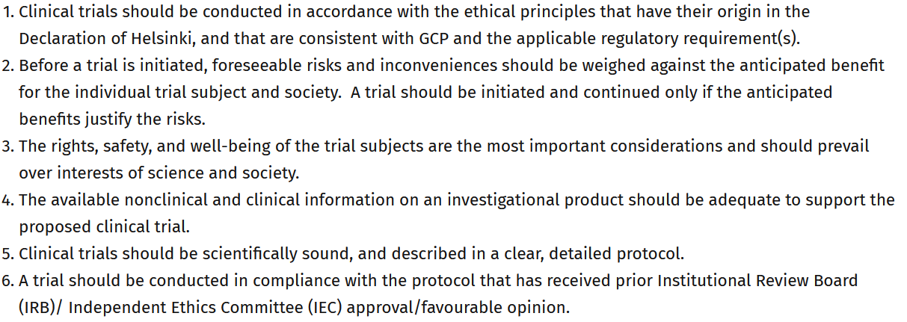
Principles of Good Clinical Practice (GCP)

Slide 17
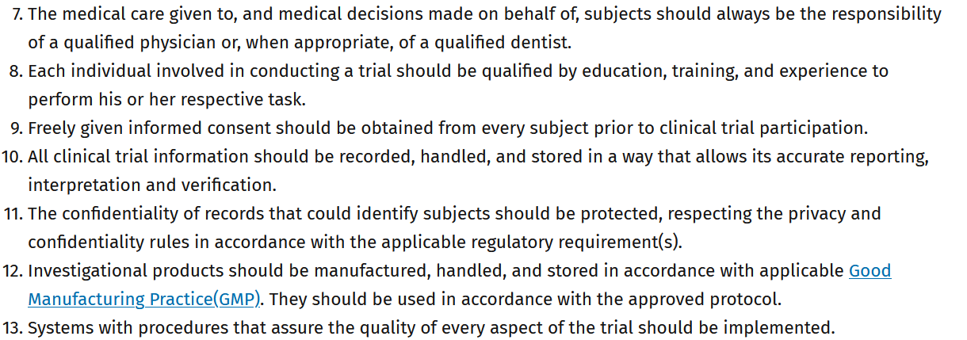
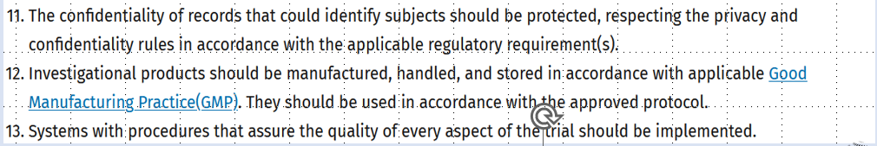
Principles of Good Clinical Practice (GCP)
This principle applied to all records referenced in this guideline, irrespective
of the type of media used.
Aspects of the trial that are essential to ensure human subject protection and reliability of trial results should be the focus of such systems.

