Slide 1



REMAP-CAP
Transition to Core Protocol V4.0
UK
Version 1.0
10 Dec 2025

Slide 2

Agenda
Welcome
Regulatory background
Core Protocol V4.0
Domain Specific Appendices – main changes
eCRF Core V4.0
Labelling/IMP Procedures
Safety
Informed Consent
Practical information
Questions & AoB
2

Slide 3
REMAP-CAP
Regulatory background

Slide 4
SM01 – Approval March 2025
After transition to CTIS early 2025
Core Protocol V4.0
PANDA & Biological Sampling Appendix (BSA)
Updated DSAs (to correspond with Core V4.0)
EU RSA V4.0 & EU RSA country appendices
New labeling approach
Corresponding country materials (ICFs)
Suitability of investigators/sites
Sponsor PI change (Marc Bonten > Lennie Derde)
4
Notes:
- Change of Coordinating Investigator from Marc Bonten to Lennie Derde
- Core Protocol V4.0
- Removal of the PAtC and introduction of the PANDA & Biological Sampling Appendix
- Corresponding updates for previous appendices (e.g. DSAs, Statistical Appendix) and new deviation annexes.
- Updated PIF/ICFs, EU RSAs, specific country appendices.
- In some countries: change of local PI for some sites
- Alternative approach on labelling of IMP
At last: Completion of the trial dossier in the system called CTIS (needed due to transition to the Clinical Trial Regulation)
Clinical Trial Info System, single entry point for submitting application/amendments in the EU/EEA.
SM = Substantial Modification

Slide 5
SM03 – Approval October 2025
SM02 does not exist due to a technicality of CTIS
Content:
DSA Influenza Immune Modulation V2.1 – 09May2025
Addition of sites
Part II documentation for countries (PI changes, updated insurance, CVs or GCP certificates)
Documents to implement sampling in NL (influenza immune modulation DSA)
5

Slide 6

SM04 - Timelines
An accelerated review for the addition of Dutch sites.
Nov 2025
Submission SM4 in CTIS of only Dutch new sites and PI changes
Approval within one week
6

Slide 7
REMAP-CAP
Core Protocol V4.0

Slide 8

Structure of the Protocol
Domain 1
Domain 3, etc.
Region-Specific Appendix (RSA)
Statistical analysis appendix
Domain 2
Pandemic Domain 2, etc.
Pandemic Domain 1
Pandemic Appendix to Core (PAtC)
Core Protocol
Biological sampling appendix
EU RSA
Country-Specific Appendix
PANDA
n/a for UK
Domain 1 deviation Appendix
Domain 2 deviation Appendix
Domain 3 deviation Appendix
8
Notes:
A major change to the structure of the REMAP-CAP Platform is the closure of the Pandemic Strata
Participants will no longer be classified as Pandemic Infection Suspected or Proven (“PISOP”) or Pandemic Infection Neither Suspected Nor Proven (“PINSNP”).
Instead, participants will be categorised on the basis of a number of factors including characteristics of the patient (e.g. age), disease (e.g. pneumonia present or absent), and likely pathogen (influenza, SARS-CoV-2, bacterial infection, etc.)
Important to highlight here that Domain deviations on country-level are described in the Domain Specific Deviation Annex → Sites should check what applies for their country!
Important to highlight that additional country-specific information (e.g. specific country= specific ICF or safety procedures) are listed in the EU RSA Country annex. Sites should read this country annex for their country!

Slide 9

Eligibility assessment
REMAP-CAP | Domain | Strata | State | Intervention | Treatment regimen
Patient with respiratory tract infection | Domain A | Non-pandemic CAP | Severe | A1 - Intervention
 |  |  |  | A2 - Intervention
 |  |  |  | A3 - Intervention
 |  | Pandemic | Severe /Moderate | A1 - Intervention | A1 – Intervention
 |  |  |  | A2 - Intervention
 |  |  |  | A3 - Intervention
 | Domain B | Non-pandemic CAP | Severe | B1 – Intervention
 |  |  |  | B2 – Intervention
 |  |  |  | B3 – Intervention
 |  | Pandemic | Severe /Moderate | B1 – Intervention
 |  |  |  | B2 – Intervention | B2 – Intervention
 |  |  |  | B3 - Intervention
Eligible for REMAP-CAP
Eligible for Domain(s)
Eligible for Intervention(s)
Randomized to Intervention(s)
9
Notes:
Presenter notes:
Eligibility for the trial is determined at multiple levels during Core V4.0:
Platform-level (Core Protocol);
(Patient, pathogen and disease-level (Patient, Pathogen ANd Disease Appendix to the Core Protocol (PANDA));)
Domain-level (Domain-Specific Appendix (DSA)); - domains specify the patient population in more detail now
Intervention-level (DSA).

Slide 10
REMAP-CAP
Changes made in Core Protocol V4.0 & PANDA

Slide 11
Reasons for Core Protocol change
Core Protocol Version 3, 10 Jul 2019 / 3.1, 09 Nov 2022 (UK)
  Major revision needed to account for new primary and secondary outcomes
  Inclusion of children and ward patients
  Incorporate learnings from past few years
  prepare the platform for the future
These modifications are a result of what we have learned throughout the COVID-19 Pandemic, and intended to future-proof the Platform
11
Notes:
NOTE: This presentation is intended to provide an overview of the major changes to the REMAP-CAP Platform in Core Protocol Version 4

Slide 12
Main Changes
Broader platform definition of “hospitalisation with respiratory tract infection”
Revised eligibility criteria
Revised endpoints
Revised/updated statistical analyses/information
Expansion to paediatrics
Removal of Pandemic Appendix to Core
Introduction of Patient, Pathogen and disease appendix (PANDA)
most domains will need to constrain eligibility to specific sub-populations
domains will specify the categories they will be using for inclusion/exclusion criteria or analytic strata and exclude all others by default
12
Notes:
NOTE:

Slide 13
Main Changes – Broader platform definition
Any reference to (severe) community-acquired pneumonia (CAP) / severe pneumonia → Respiratory tract infections
Any reference to (admitted to) ICU → (admitted to) hospital/hospitalized
Removal of references to adults
Example: aim (synopsis)
  V3 – old: The primary objective of this REMAP is, for patients with severe CAP who are admitted to an ICU, to identify the effect of a range of interventions to improve outcome as defined by all-cause mortality at 90 days.
  V4 – new: The primary objective of this platform trial is, for patients hospitalized with respiratory tract infection, to identify the effect of a range of interventions to improve patient outcomes.
13
Notes:
NOTE: Eligibility will no longer be constrained to adult patients who are hospitalised with severe CAP. Any hospitalised patient with a respiratory tract infection is potentially eligible for the Platform.

Slide 14
Main Changes – Platform eligibility criteria
One of the most significant changes is the expansion of the patient population who are eligible for the Platform.
Eligibility will no longer be constrained to adult patients who are hospitalised with severe CAP. Any hospitalised patient with a respiratory tract infection is potentially eligible for the Platform.
The eligibility criteria for the platform are applied at multiple levels
  All Platform inclusion criteria are met
  None of the Platform exclusion criteria are met
  Domain-specific eligibility criteria are met
  The patient is eligible for at least two interventions within a domain
14
Notes:
NOTE:

Slide 15
Main Changes – Revised Inclusion Criteria
  In order to be eligible for this trial, patients must be
  1. Aged ≥ 28 days
  2. Hospitalisation
  3. Have an acute respiratory tract infection
15
Notes:
NOTE:

Slide 16
Main Changes – Revised Exclusion Criteria
Patients who meet any of the following criteria will be excluded from participation in this trial:
1. Remains: Death is deemed to be imminent and inevitable during the next 24 hours AND one or more of the patient, substitute decision maker or attending physician are not committed to full active treatment.
2. New: Patient is expected to be discharged from hospital within the next 24 hours (was already part of UK protocol)
3. Revised wording: Previous enrollment in this Platform trial within the last 90 days
Removed:
Healthcare-associated pneumonia:
a. Prior to this illness, is known to have been an inpatient in any healthcare facility within the last 30 days
b. Resident of a nursing home or long-term care facility.
16
Notes:
NOTE:
This means that: 1) patients who are hospitalized primarily for a reason other than their respiratory tract infection or 2) patients with hospital-acquired infections can also be included.

Slide 17
Main Changes – Revised Primary Endpoint
Primary endpoint = Survival and Recovery Trajectory, a composite of 90-day all-cause mortality and, among survivors, a daily ordinal scale analyzed as a trajectory of illness and recovery to 28 days.
  Mortality at Day 90 post-randomization
  Among Day-90 survivors, daily respiratory support level as defined by five-category ordinal scale:
    Hospitalized on extracorporeal life support (ECLS) or invasive mechanical ventilation (IMV)
    Hospitalized on non-invasive ventilation or high-flow oxygen*
    Hospitalized on low-intensity oxygen
    Hospitalized, no oxygen
    Discharged from index hospitalization
17
Notes:
NOTE: * High-flow oxygen defined as a fractional inspired oxygen concentration of 0.4 or higher and with flow rate of at least 30 liters per minute (or at least 2 liters per minute per kilogram of bodyweight in children less than 15 kilograms).

Slide 18
Patient, Pathogen and disease appendix
(PANDA)
Specifies conditions, within the larger population of respiratory tract infection, where specific Strata are defined
Does not include information about interventions
Includes information about the relevant categories of patients within those hospitalized with respiratory tract infection who are eligible for enrolment in the Platform
  describes how specific patient, pathogen, disease, illness severity and additional clinical features are defined and categorized
PANDA may be amended in the context of a future pandemic, but it is intended that any amendments to the PANDA will be infrequent
18
Notes:
NOTE: defines factors including characteristics of the patient (e.g. age), disease (e.g. pneumonia present or absent), and likely pathogen (influenza, SARS-CoV-2, bacterial infection, etc.)

Slide 19
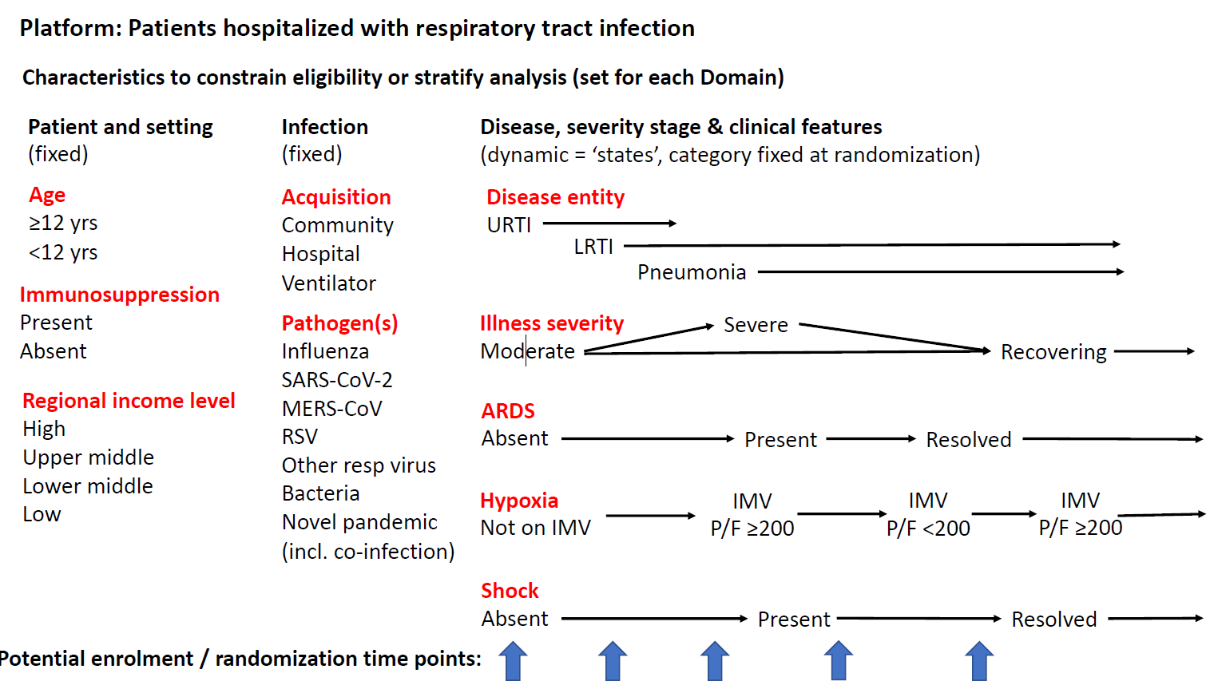
Patient, Pathogen and disease appendix
(PANDA)
≥ 18 yrs
≥ 12 yrs ≤ 18 yrs
≥ 28 days ≤ 12 yrs
19
Notes:
NOTE:

Slide 20
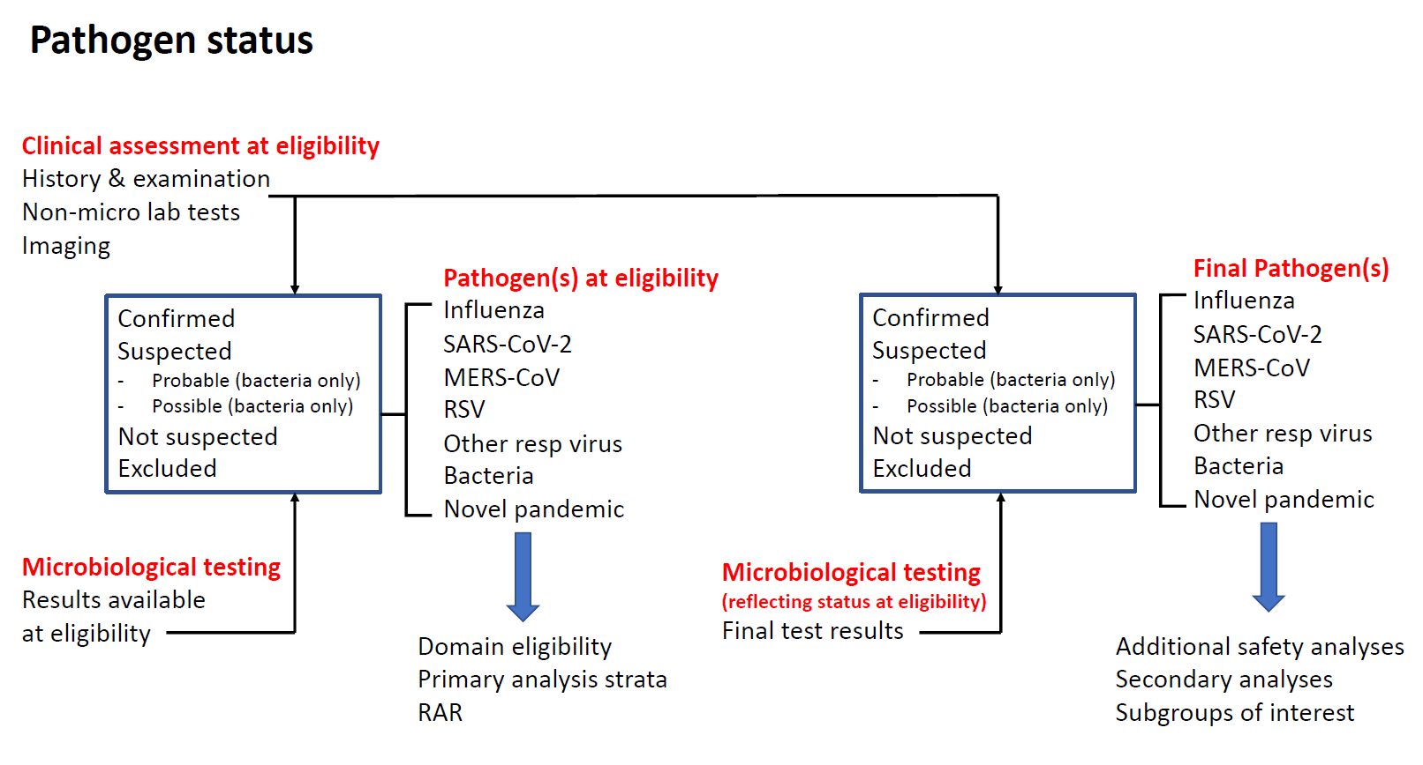
Patient, Pathogen and disease appendix
(PANDA)
20
Notes:
NOTE: In this Platform, pathogen status for eligibility (either immediately or by delayed reveal) or for analysis may be assigned based on clinical assessment, microbiological testing, or both. Each DSA will specify which pathogens are relevant to the domain. For each pathogen, a hierarchy of infection likelihood exists consisting of ‘confirmed’, ‘suspected’ (divisible, for bacterial infection, into two subcategories: ‘probable’ and ‘possible’), ‘not suspected’, and ‘excluded’ based on the clinical assessment and microbiological test results. For the presence of a pathogen to be ‘confirmed’ or ‘excluded’, there must be supportive microbiological testing.
Domains may also constrain eligibility according to additional criteria related to the nature of the sample undergoing microbiological tests, the time-window in which the sample is collected, and microbiological testing types.
a domain can restrict eligibility by specifically including or excluding patients with a specific pathogen status (including co-infection) as domain eligibility criteria e.g. a domain could include participants with influenza virus infection, exclude patients with confirmed SARS-CoV-2 infection and exclude participants who have bacterial co-infection

Slide 21
Platform-Level Modifications
Core Protocol V4 also adds the Recovering State
Recovering State is defined as:
  Hospitalised patients who, in the opinion of the treating clinician, are clearly recovering from their acute respiratory tract infection AND are unlikely to require or receive a significant escalation in level of organ failure support for the remainder of their hospital admission
Currently no domains are available for patients in the Recovering State, meaning that they cannot be randomised into the Platform
  Future domains may permit enrolment of patients in the Recovering State
21
Notes:
NOTE:

Slide 22
Main Changes - Statistics
Merge two statistical models (interpandemic and pandemic), & possibly Ventilation Domain
New trigger terminology added
  Possible treatment effects : superiority, efficacy, inferiority, equivalence, noninferiority, futility, and harm
  Core protocol sets default thresholds for statistical triggers
Adaptive analyses will occur frequently, approximately proportional to the rate of recruitment
Response Adaptive Randomization: proportions determined by analysis of the available data informing the primary outcome measure in participants after at least 28-days of follow-up
  For domains with only two available interventions, default is that RAR will not be applied
  Allocation proportions capped at 60% for two-intervention domains, unless otherwise specified
22
Notes:
NOTE:

Slide 23
REMAP-CAP
Domain Specific Appendices

Slide 24
Domain-level updates
Many of the changes to existing Domain-Specific Appendices (DSAs) are in response to changes to the Core Protocol.
The broadening of Platform-level eligibility criteria mean that domain-level eligibility criteria have been updated to ensure continuity.
Although it may look like there are a lot of changes, in practice the patients who are eligible for these domains will be the same as were eligible under previous versions.
In most cases there are no changes to interventions or their delivery.

Slide 25
DSAs – General changes
Removal of pandemic/non-pandemic strata. Suspected or confirmed pathogens are incorporated in eligibility criteria.
Addition of moderate state for several domains. (C V6.0, I V3.0)
Domain | Moderate State | Severe State
Antibiotic Domain | 🗶 | ✔
Macrolide Duration Domain | 🗶 | ✔
Corticosteroid Domain | ✔ | ✔
Influenza Antiviral Domain | ✔ | ✔
Immunoglobulin Domain | ✔ | ✔
Mechanical Ventilation Domain | 🗶 | ✔ - n/a UK
Endothelial Domain | 🗶 | ✔- n/a UK
Influenza Immune Modulation Domain | 🗶 | ✔
25
Notes:
NOTE:

Slide 26
DSAs – General changes
Addition of age strata. Children remain to be excluded in EU region, except for UK.
Domain | Paediatric (≥28 days) | Adolescent (≥12 years) | Adult (≥18 years)
Antibiotic Domain | 🗶 | 🗶 | ✔
Macrolide Duration Domain | 🗶 | 🗶 | ✔
Corticosteroid Domain | ✔ | ✔ | ✔
Influenza Antiviral Domain | ✔ | ✔ | ✔
Immunoglobulin Domain | 🗶 | ✔ (≥16 years) | ✔
Mechanical Ventilation Domain | 🗶 | 🗶 | ✔ - n/a UK
Endothelial Domain | 🗶 | 🗶 | ✔ - n/a UK
Influenza Immune Modulation Domain | ✔ (≥2 years) | ✔ | ✔
26
Notes:
NOTE:

Slide 27
Domain Specific Appendices (DSAs)
Refer to DSAs for:
Domain specific eligibility criteria
Domain rationale
Concomitant care
Potential domain-specific adverse events
Domain-specific endpoints
Domain-specific protocol deviations
Other domain specific information
In addition review DSA, DSA Deviations annexes and DSA training slides
Reach out to the Project Team with any questions
27
Notes:
NOTE:

Slide 28
REMAP-CAP eCRF Core V4.0

Slide 29
eCRF Changes
The REMAP-CAP case report form (CRF) has undergone a thorough review and substantial update. These changes are intended to:
  Reflect changes to Core Protocol V4;
  Reduce burden of data collection by removing unnecessary fields / finding more efficient ways of capturing necessary data; and
  Future-proof for any future public health emergencies.
29
Notes:
NOTE:

Slide 30
Eligibility Form Changes (1)
The eligibility assessment was updated to:
  Reflect the reduced Platform eligibility criteria;
  Reflect modifications to domain-specific eligibility criteria; and
  Manage the complexity of simultaneously assessing eligibility for multiple domains and interventions.
30
Notes:
NOTE:

Slide 31

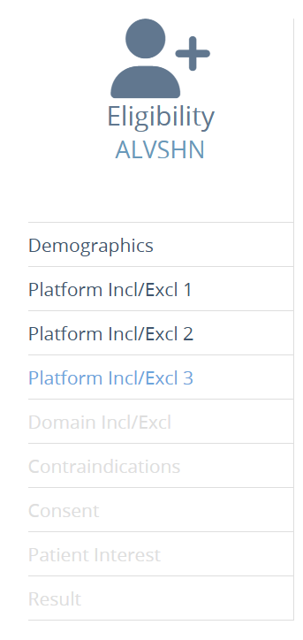
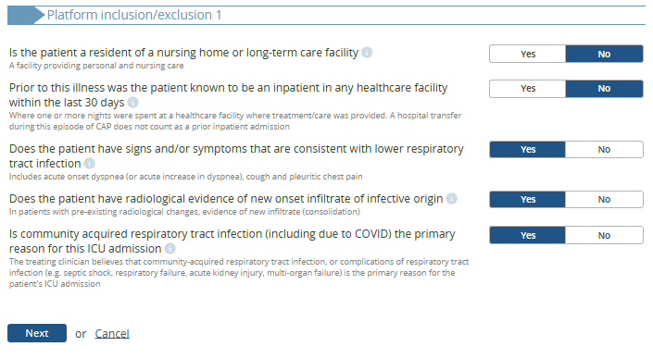
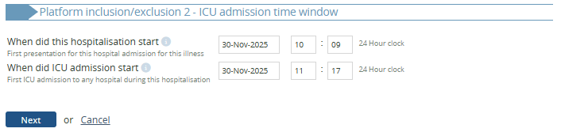
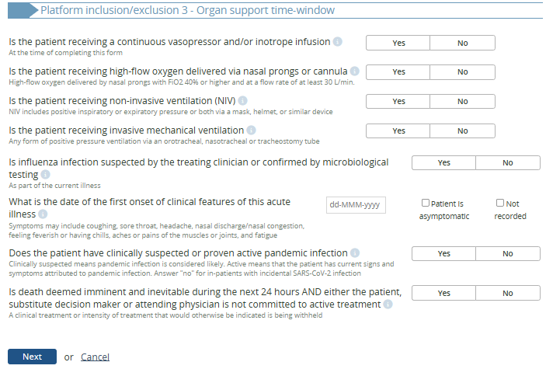

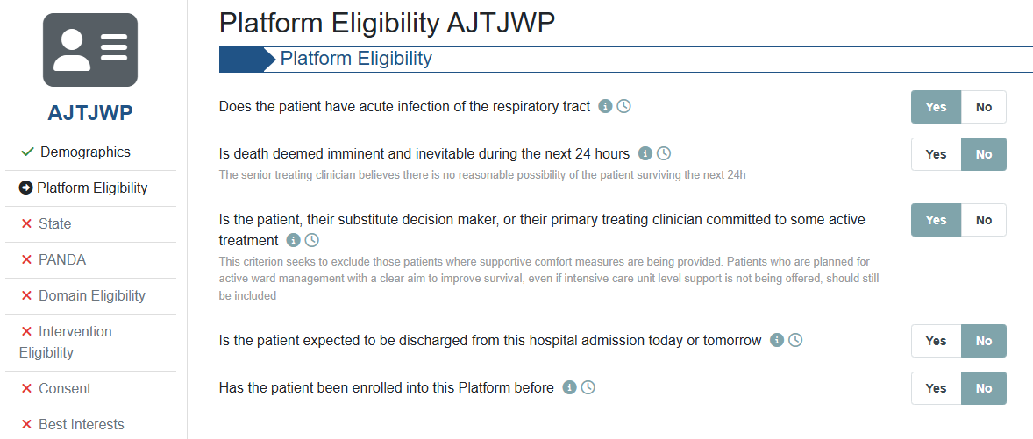
Eligibility Form Changes (2)
  ±20 platform eligibility questions on 3 pages
  5 platform eligibility questions on 1 page
  New system
  Old system
  Fewer questions necessary to assess Platform eligibility
31
Notes:
NOTE:

Slide 32
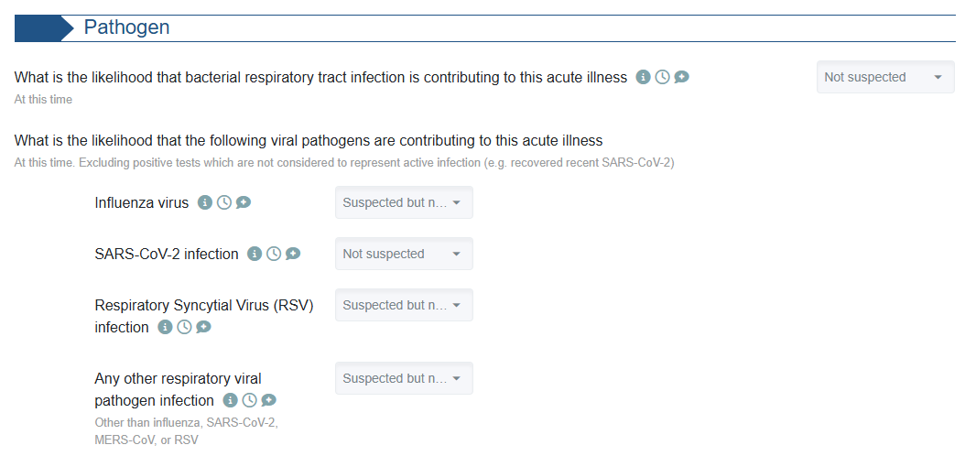
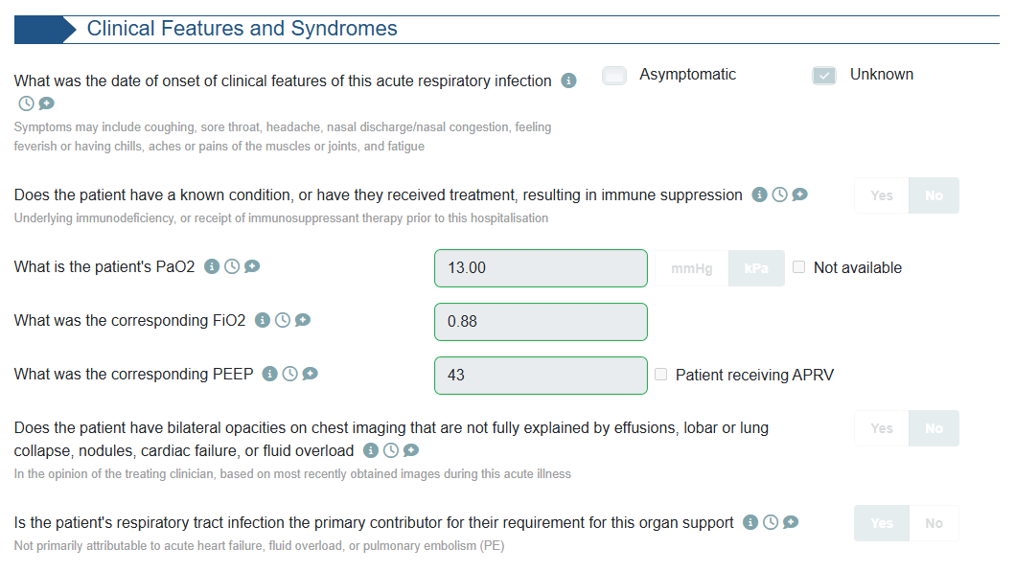
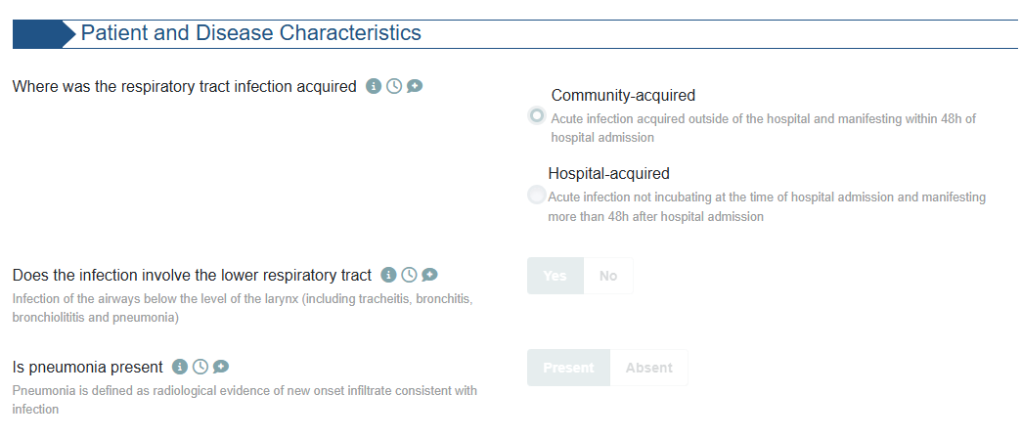
Eligibility Form Changes (3)
  New pages added for “PANDA”, to continue eligibility assessment based on …
  New system
32
Notes:
NOTE:

Slide 33
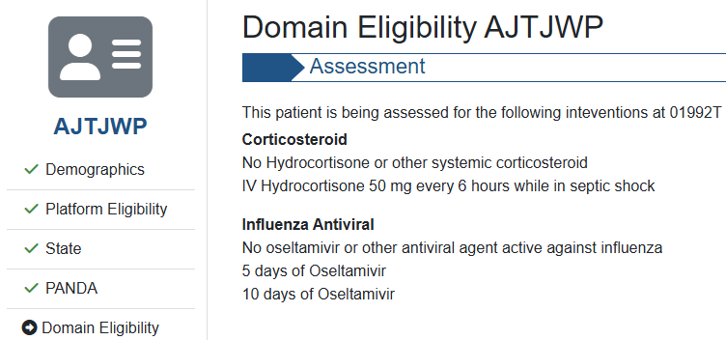

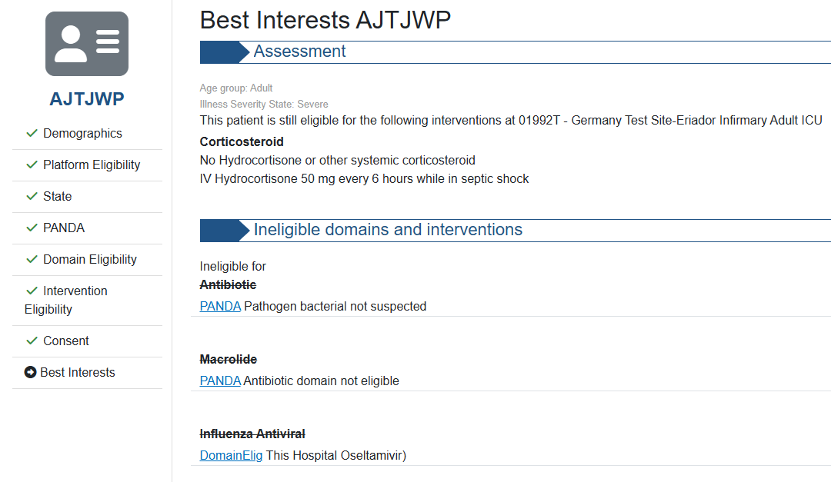
Eligibility Form Changes (4)
  Clearer output for users regarding which domains a participant is being assessed for on the “Domain Eligibility” page…
  New system
  … and why participants are ineligible for certain domains on the “Best Interests” page.
  New system
33
Notes:
NOTE:

Slide 34
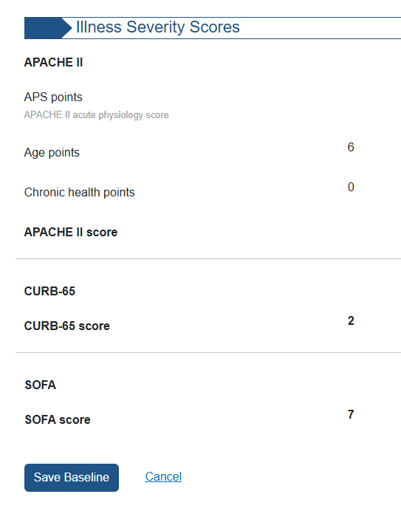
Baseline Form Changes
Some questions in the Baseline Form have been made domain-specific.
Some questions in the Baseline Form have been removed.
Illness Severity Scores are now calculated automatically by the database for ICU patients, based on data entered in the Baseline Form.
  New system
34
Notes:
NOTE:
Some questions have been made domain-specific > e.g. pregnancy, type of immune-suppressive therapy, COVID-19 / Influenza vaccination status.
Some questions have been removed > e.g., hospital admission source, smoking status, hazardous alcohol consumption, whether the patient is a healthcare worker.

Slide 35
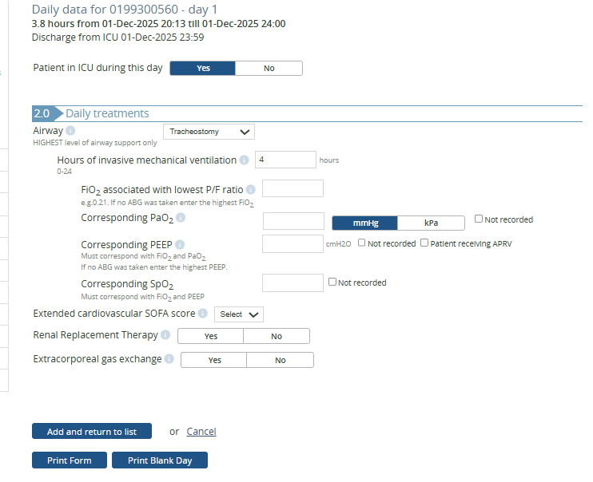
Daily Data Form Changes (1)
Daily Data Form focuses on organ support.
Study days are now defined by calendar days, instead of ICU chart days.
  Old system
35
Notes:
NOTE:

Slide 36
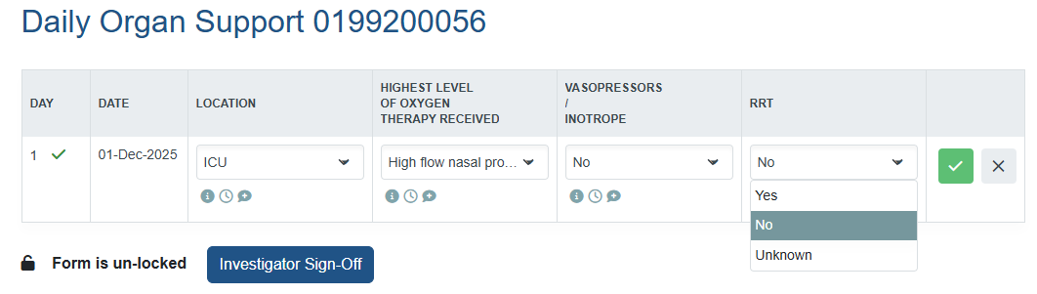
Daily Data Form Changes (2)
Daily Data Form focuses on organ support.
Study days are now defined by calendar days, instead of ICU chart days.
  New system
36
Notes:
NOTE:

Slide 37
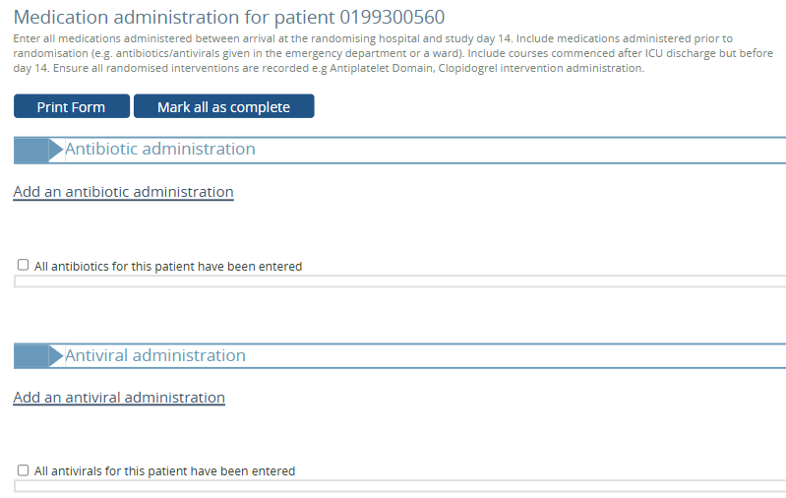
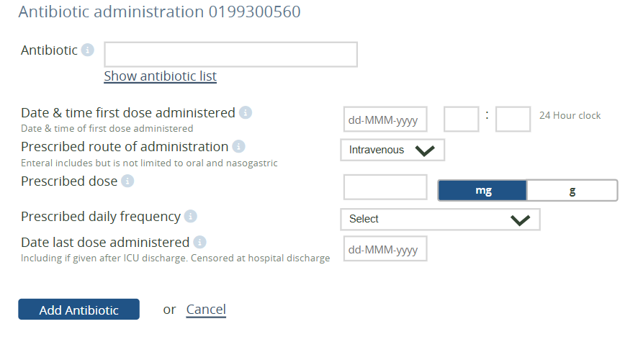
Medication Admin. Form Changes (1)
Non-allocated medications of interest will be collected in a “Yes / No” format.
Data collection will be domain-specific.
Medication Administration Form focuses on daily administration of allocated intervention, instead of details of each prescribed course.
  Old system
37
Notes:
NOTE:

Slide 38
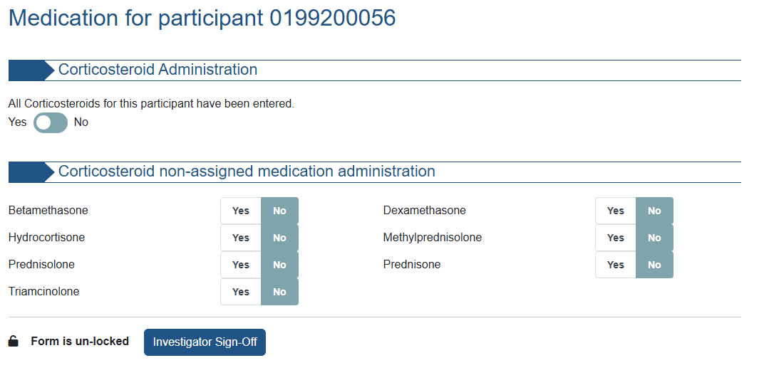
Medication Admin. Form Changes (2)
Non-allocated medications of interest will be collected in a “Yes / No” format.
Data collection will be domain-specific.
Medication Administration Form focuses on daily administration of allocated intervention, instead of details of each prescribed course.
  New system
38
Notes:
NOTE:

Slide 39
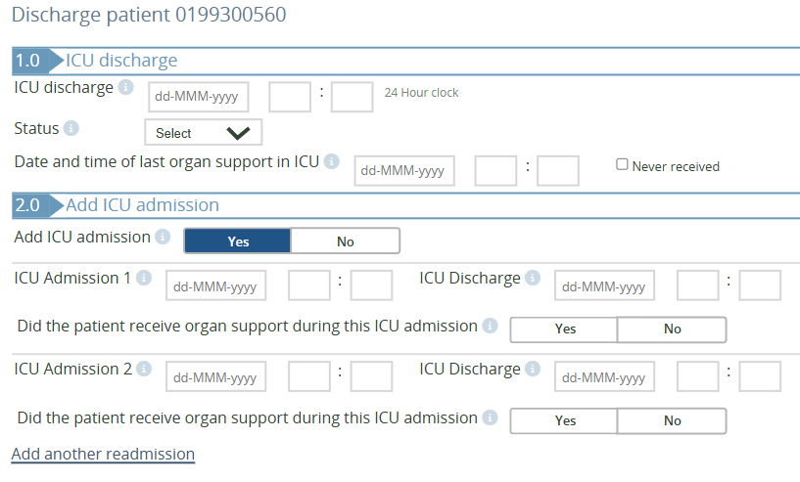
Discharge Form Changes (1)
The Discharge Form has been modified to more clearly capture participant movement during the acute hospital admission, including between hospitals in case of transfers.
  Old system
39
Notes:
NOTE:

Slide 40
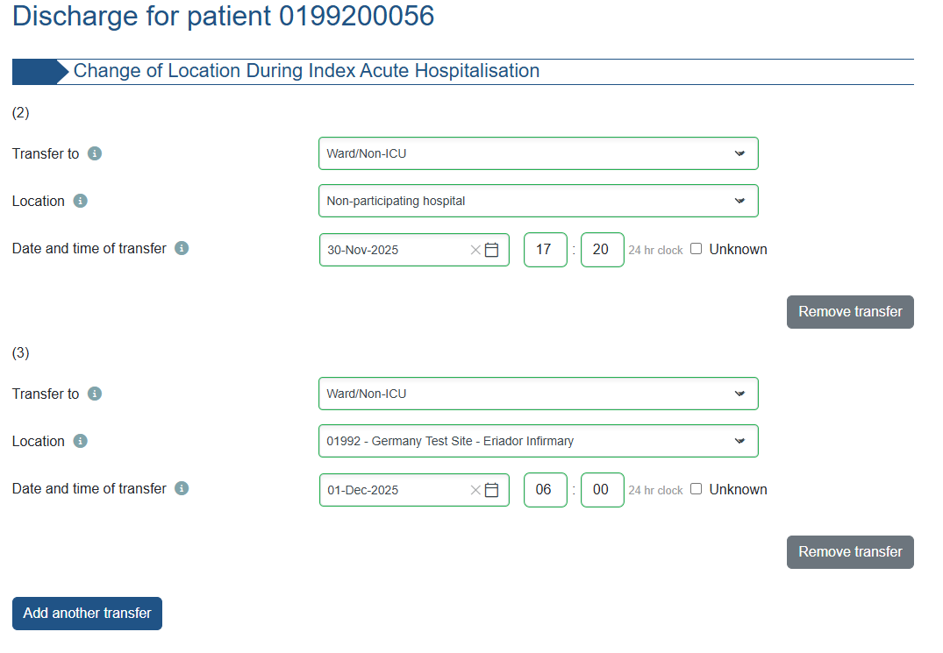
Discharge Form Changes (2)
  New system
The Discharge Form has been modified to more clearly capture participant movement during the acute hospital admission, including between hospitals in case of transfers.
40
Notes:
NOTE:

Slide 41
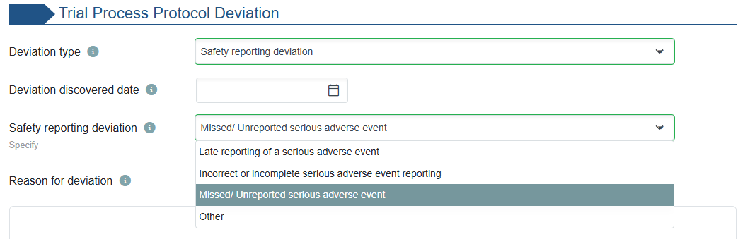
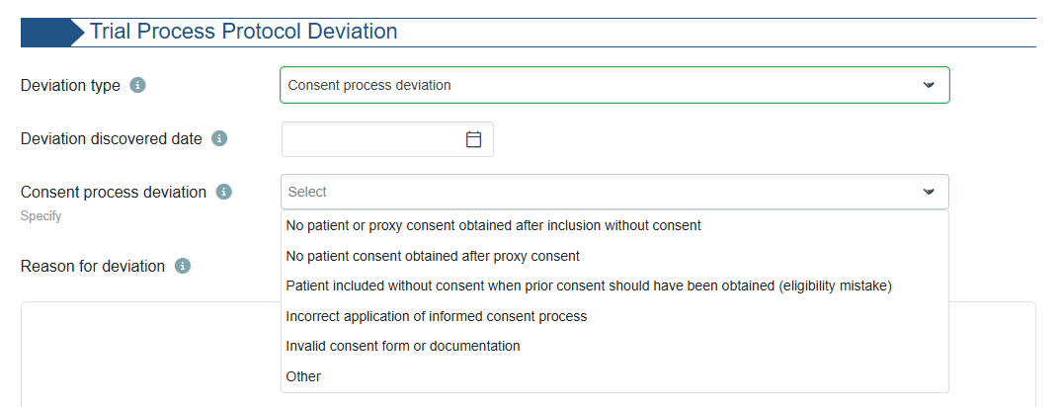

Protocol Deviation Form Changes
The Protocol Deviation Form now allows entries that relate to trial processes, including safety reporting and consent processes.
  New system
41
Notes:
NOTE:

Slide 42
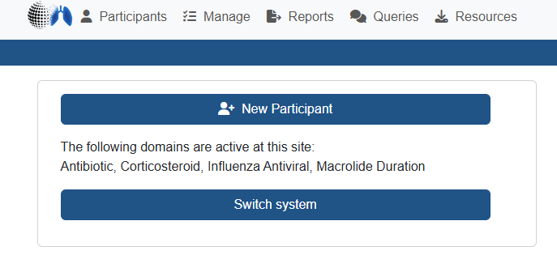
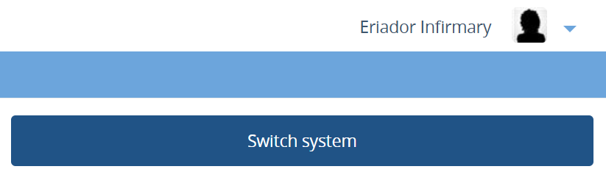
Old system vs. new system (1)
Training documentation for new database system is required.
Once your site is activated for Core Protocol V4.0, your eCRF accounts will be linked to the new database system.
You can access the entered eCRF data under both database systems by selecting the “Switch System” button on your landing page.
  Old system
  New system
42
Notes:
NOTE:

Slide 43
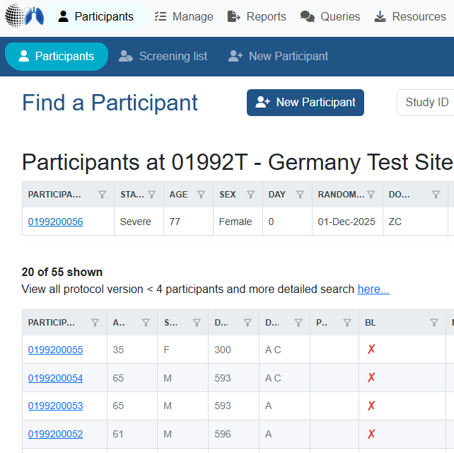
Old system vs. new system (2)
Only new patients recruited under Core Protocol V4.0 are saved in the new database system.
  New system
Previously enrolled participants under Core Protocol V3.0 remain in the old database system. No reconsent is needed for patients recruited under Core V3.0 (no changes in protocol).
43
Notes:
NOTE:

Slide 44
REMAP-CAP
Labelling/IMP Procedure

Slide 45
Labelling
Under CTD, there was national variation in labelling requirements for IMP. With the CTR, clinical trials are assessed uniformly across all Member States. As a result, our labelling strategy is now aligned across all EU countries. Authorized IMP used on- or off-label will not be labelled.
IMP that is supplied by pharmaceutical companies will be supplied with a label.
The simplified label is no longer applicable if it was previously used at your site. IMP that is currently labelled, can still be used.
45
Notes:
NOTE: Omission of the simplified label applies to Belgium, Czech Republic, Ireland, Netherlands Italy and Slovenia

Slide 46
IMP: hospital stock and external supplier
Baloxavir & Tocilizumab are provided by Roche from clinical trial stock and is supplied with clinical trial labelling;
All other IMP from hospital stock
Different procedures to be followed for IMP from external suppliers (Roche)
  Training on ordering, temperature and storage monitoring, drug accountability and destruction is provided prior to activation of domains
For IMP from hospital stock: site’s routine procedures to be followed for drug accountability, destruction and temperature monitoring
  As long as information is clearly captured and accountability can be monitored from drug charts/medical notes
46
Notes:
NOTE: Procedures regarding ordering, temperature and storage monitoring, drug accountability and destruction

Slide 47
REMAP-CAP
Safety

Slide 48
Safety Reporting
Safety reporting is aligned in all EU countries under CTR, and safety event definitions were updated in protocol.
Only protocol defined SAEs need to be reported
  1. Pre-specified SAEs in the DSA,
  2. SAEs deemed to be possibly, probably or definitely related to study treatment / participation.
It is expected that site investigators make an initial (documented) assessment on event severity, relatedness and expectedness:
  An SAE is considered ‘expected’ if the nature and severity of the event is consistent with the current approved version of the reference safety information.
  Expected should be assessed “from the perspective of previously observed, not on the basis of what might be anticipated from the pharmacological properties of a medicinal product” (ICH E2A, 1994).
48
Notes:
NOTE: Reference Safety information: (e.g., summary of product characteristics / investigator brochure / protocol documents).

Slide 49
REMAP-CAP
Informed Consent

Slide 50
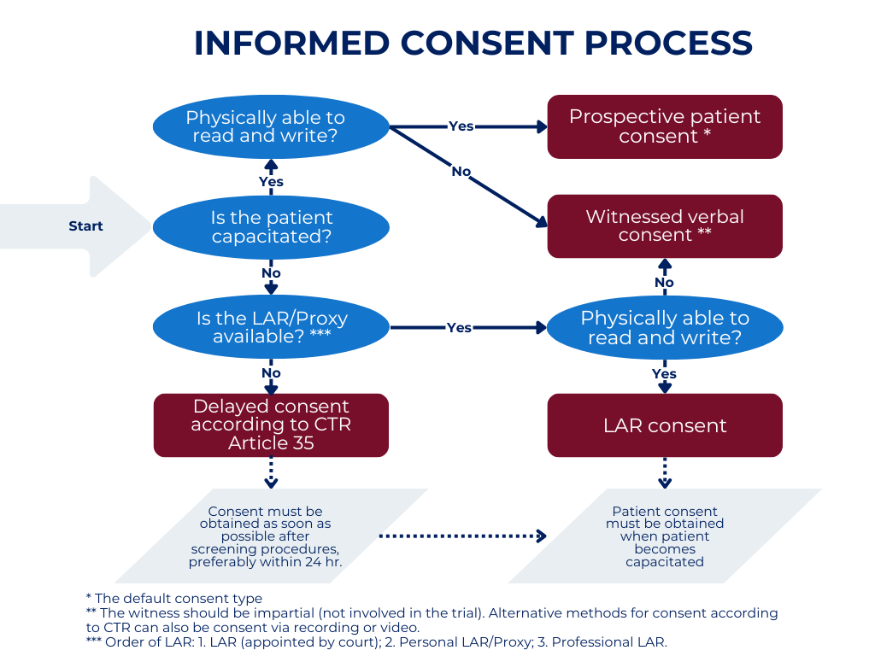
Informed Consent
Obtaining Informed Consent in emergency setting is now described in the EU RSA V4 for all countries and aligned with CTR requirements
EU RSA UK country annex lists approved consent types and procedures, as described in refresher training session.
* Prospective patient consent is the default consent type.
** In case of verbal consent, the witness should be impartial (not involved in the trial). Alternative methods for consent according to CTR can also be consent via recording or video.
*** Order of LAR priority:
    LAR appointed by court
    Personal LAR / proxy
    Professional LAR
50
Notes:
For participants that remain incapacitated at hospital discharge, sites are expected to check at least at day 90 and day 180 if the subject has regained capacity to provide consent, if still alive.

Slide 51
REMAP-CAP
ICH-GCP & GDPR

Slide 52
ICH-GCP E6 R3
Effective date was 23rd July 2025 in the EU.
Mandatory in the UK as of 28th April 2026.
Please file your (updated) GCP certificates in the ISF and share with your TM team for TMF filing.
52
Notes:
NOTE:

Slide 53
REMAP-CAP
Practical Information

Slide 54

What’s next?
We will contact sites to (re-)confirm domain and intervention participation.
Expected from Sites
Attend Core V4 update training / self-training via recording
Provide (self-) training log for:
  Core Protocol V4 and eCRF updates
  EU RSA V4 & Country Annex - UK
  PANDA
  (Updated) DSAs including DSA Deviation Annexes
Provide completed Protocol Signature Page and Choice Pages
Provide Spiral Database Form, in case of changes in domain/intervention selection
Documents to be filed in ISF
GREEN LIGHT
54
Notes:
NOTE: Please mention that it is the responsibility of the PI that all site study staff has been trained on Core V4 before performing any Core V4 study related tasks!

Slide 55
What’s next?
Delivered to Site
Self-training log with all mandatory documents/slide decks listed for self-training
Updated eCRF guides and associated eCRF documents
Protocol documents and PIS/CFs already sent as part of Am43
Site staff should be trained on Core V4 and provide all documents before conducting any Core V4 trial-related tasks!!!
55
Notes:
NOTE: Please mention that it is the responsibility of the PI that all site study staff has been trained on Core V4 before performing any Core V4 study related tasks!

Slide 56
REMAP-CAP
Questions & AoB

Slide 57
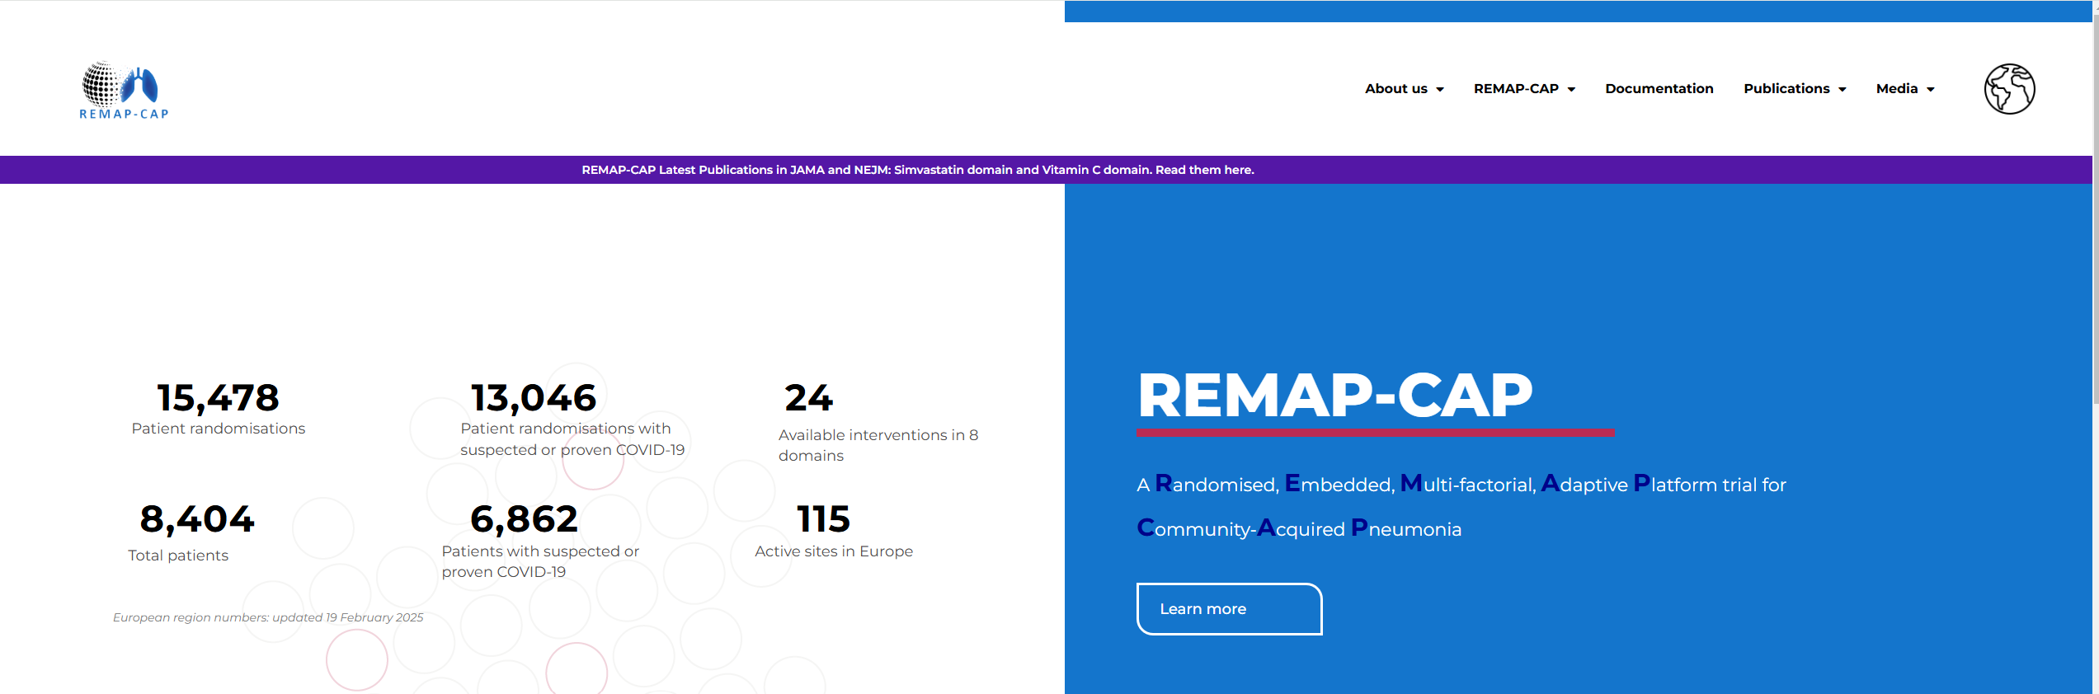
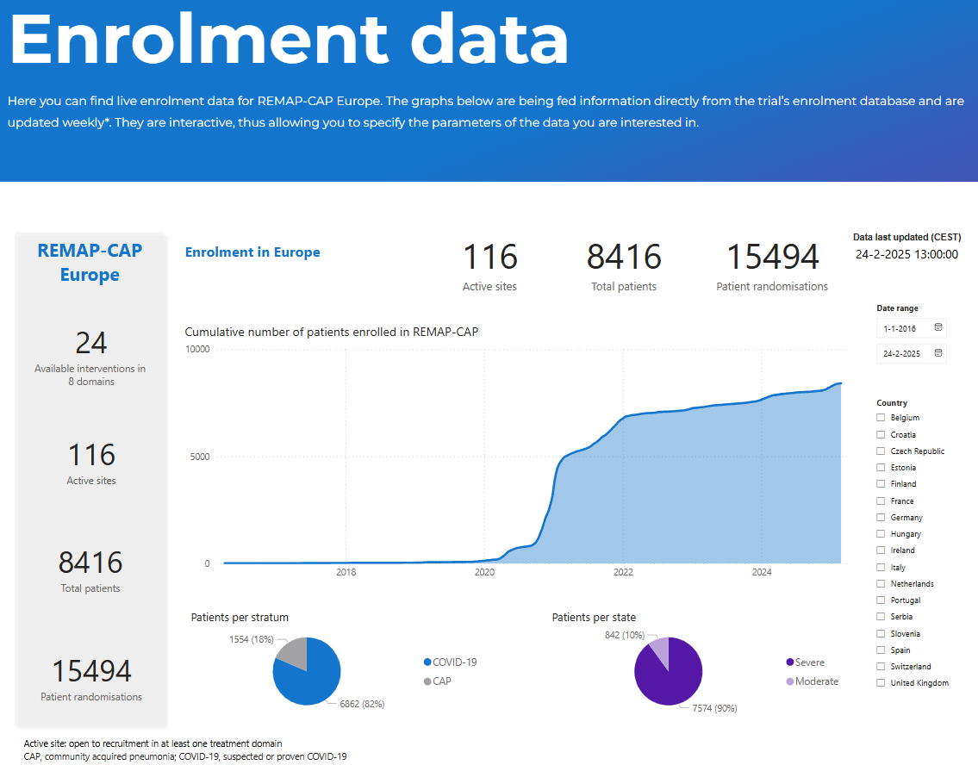
Stay up to date
www.remapcap.co.uk
Recruitment updates
Newsletters
Instagram https://www.instagram.com/remapcap/
LinkedIn https://www.linkedin.com/company/remap-cap/mycompany/
57
Notes:
NOTE:

Slide 58
Contacts
General e-mail address (always in cc):
ukremap-cap@icnarc.org
Aisha Anjum 07956 800722
Janis Best-Lane 07714 051680
Lucy Stronach 07714 051401
For urgent situations outside office hours if UK team cannot be reached
info@remapcap.org
58
Notes:
NOTE:

Slide 59
THANK YOU FOR JOINING!
59
Notes:
NOTE:

