Slide 1



REMAP-CAP
Transition to Core Protocol V4.0
UK
Version 4.1
05 MAR 2026
(with audio)

Slide 2

Agenda
Welcome
Regulatory background
Core Protocol V4.0
Domain Specific Appendices – main changes
eCRF Core V4.0
IMP Procedures
Safety
Informed Consent
Practical information
Questions & AoB
2

Slide 3
REMAP-CAP
Regulatory background

Slide 4
SM01 – Approval March 2025
After transition to CTIS early 2025
Core Protocol V4.0
PANDA & Biological Sampling Appendix (BSA)
Updated DSAs (to correspond with Core V4.0)
EU RSA V4.0 & EU RSA country appendices
New labeling approach
Corresponding country materials (ICFs)
Suitability of investigators/sites
Sponsor PI change (Marc Bonten > Lennie Derde)
4
Notes:
- Change of Coordinating Investigator from Marc Bonten to Lennie Derde
- Core Protocol V4.0
- Removal of the PAtC and introduction of the PANDA & Biological Sampling Appendix
- Corresponding updates for previous appendices (e.g. DSAs, Statistical Appendix) and new deviation annexes.
- Updated PIF/ICFs, EU RSAs, specific country appendices.
- In some countries: change of local PI for some sites
- Alternative approach on labelling of IMP
At last: Completion of the trial dossier in the system called CTIS (needed due to transition to the Clinical Trial Regulation)
Clinical Trial Info System, single entry point for submitting application/amendments in the EU/EEA.
SM = Substantial Modification

Slide 5
SM03 – Approval October 2025
SM02 does not exist due to a technicality of CTIS
Content:
DSA Influenza Immune Modulation V2.1 – 09May2025
Addition of sites
Part II documentation for countries (PI changes, updated insurance, CVs or GCP certificates)
Documents to implement sampling in NL (influenza immune modulation DSA)
5

Slide 6

SM04 - Timelines
An accelerated review for the addition of Dutch sites.
Nov 2025
Submission SM4 in CTIS of only Dutch new sites and PI changes
Approval within one week
6

Slide 7

Structure of the Protocol
Domain 1
Domain 3, etc.
Region-Specific Appendix (RSA)
Statistical analysis appendix
Domain 2
Pandemic Domain 2, etc.
Pandemic Domain 1
Pandemic Appendix to Core (PAtC)
Core Protocol
Biological sampling appendix
EU RSA
Country-Specific Appendix
NEW: PANDA
n/a for UK
NEW: Domain 1 deviation Appendix
NEW: Domain 2 deviation Appendix
NEW: Domain 3 deviation Appendix
n/a for UK, for now
2
Notes:
Include in audio:
A major change to the structure of the REMAP-CAP Platform is the closure of the Pandemic Strata
Participants will no longer be classified as Pandemic Infection Suspected or Proven (“PISOP”) or Pandemic Infection Neither Suspected Nor Proven (“PINSNP”).
Instead, participants will be categorised on the basis of a number of factors including characteristics of the patient (e.g. age), disease (e.g. pneumonia present or absent), and likely pathogen (influenza, SARS-CoV-2, bacterial infection, etc.) as described in the PANDA
Domain deviation annexes are n/a for the UK at the moment, but may become applicable in the future in case of a UK-specific deviation.
Important to highlight here that Domain deviations on country-level are described in the Domain Specific Deviation Annex → Sites should check what applies for their country!
Important to highlight that additional country-specific information (e.g. specific country= specific ICF or safety procedures) are listed in the EU RSA Country annex. Sites should read this country annex for their country!

Slide 8
REMAP-CAP
Core Protocol V4.0

Slide 9
REMAP-CAP
Changes made in Core Protocol V4.0 & PANDA

Slide 10
Reasons for Core Protocol change
Core Protocol Version 3.1, 09 Nov 2022 (UK)
  Major revision needed to account for new primary and secondary outcomes
  Wording to include paediatrics and wards
  Closure of the Pandemic Strata
  Reflect what we have learned throughout the COVID-19 Pandemic, and intend to future-proof the Platform (background /design)
  Removal of outdated information
10
Notes:
NOTE: This presentation is intended to provide an overview of the major changes to the REMAP-CAP Platform in Core Protocol Version 4

Slide 11
Main Changes
Broader platform definition
Revised eligibility criteria
Revised primary outcomes and endpoints
Removal of Pandemic Appendix
Introduction of Patient, Pathogen and Disease Appendix (PANDA)
Clarification for transferred patients
Addition of PedsQL for paediatrics
Addition of a ‘Recovering’ state
Revised/updated statistical information
4
Notes:
NOTE:
Reflect what we have learned throughout the COVID-19 Pandemic, and intend to future-proof the Platform (background /design).
Removal of outdated information.

Slide 12
1. Broader Platform Definition
Any reference to ‘(severe) community-acquired pneumonia (CAP)’ / ‘severe pneumonia’ → Respiratory tract infections
Any reference to ‘(admitted to) ICU’ → (admitted to) hospital/hospitalized
Removal of references to adults
Example: aim (synopsis)
  V3.1 – old: The primary objective of this REMAP is, for patients with severe CAP who are admitted to an ICU, to identify the effect of a range of interventions to improve outcome as defined by all-cause mortality at 90 days.
  V4 – new: The primary objective of this platform trial is, for patients hospitalized with respiratory tract infection, to identify the effect of a range of interventions to improve patient outcomes.
5
Notes:
NOTE: Wording inclusive of paediatrics and wards

Slide 13
2. Broader Platform Eligibility Criteria
Any hospitalised patient with a respiratory tract infection is potentially eligible for the Platform.
Simplified Inclusion criteria:
  1. Aged ≥ 28 days* (*CGA for paeds)
  2. Hospitalised
  3. Have an acute respiratory tract infection
    Includes patients hospitalised with a primary reason other than respiratory tract infection
    Includes hospital-acquired infections
  (Removal of the requirement for the patient to have community-acquired pneumonia)
6
Notes:
NOTE: As per broader definition, eligibility will no longer be constrained to patients who are hospitalised with severe CAP. Any required constraints have been moved to relevant domain eligibility criteria.

Slide 14
Exclusion criteria:
Removal of ‘14 days has elapsed since hospital admission’
Other minor wording changes
Eligibility criteria for the study are still applied at multiple levels:
  All Platform inclusion criteria met and no exclusion criteria
  Domain-specific eligibility criteria met
  Patient eligible for at least two interventions within a domain
7
Notes:
NOTE:
Removal of 14 days since hospital admission exclusion allows inclusion of healthcare/care-facility associated pneumonia

Slide 15
Exclusion Criteria
Patients who meet any of the following criteria will be excluded from participation in this trial:
Remains: 1. Death is deemed to be imminent and inevitable during the next 24 hours AND one or more of the patient, substitute decision maker or attending physician are not committed to full active treatment.
New to EU but already part of UK: 2. Patient is expected to be discharged from hospital within the next 24 hours
Minor revised wording: 3. Previous enrollment in this Platform trial within the last 90 days
Removal of 14 days since hospital admission exclusion
15
Notes:
NOTE:

Slide 16
3. Revised Primary Endpoint
Primary endpoint: Survival and Recovery Trajectory - a trajectory of illness and recovery to 28 days.
All cause mortality at Day 90 post-randomisation
Among Day-90 survivors, daily respiratory support level as defined by five-category ordinal scale:
    Hospitalized on extracorporeal life support (ECLS) or invasive mechanical ventilation (IMV)
    Hospitalized on non-invasive ventilation or high-flow oxygen*
    Hospitalized on low-intensity oxygen
    Hospitalized, no oxygen
    Discharged from index hospitalisation
    High-flow oxygen defined as a fractional inspired oxygen concentration of 0.4 or higher and with flow rate of at least 30 liters per minute (or at least 2 liters per minute per kilogram of bodyweight in children less than 15 kilograms).
Does not change data collection required by sites at follow-up
8
Notes:
NOTE:
Single primary endpoint designed to encompass all illness severity states
Builds on experience with of primary endpoints utilised during previous versions of the Core Protocol and Pandemic Appendix
Intended to:
Be patient centred
Allow continuity with previous endpoints
Enhance statistical power

Slide 17
4. Removal of Pandemic Appendix to Core
Closure of pandemic strata.
Participants will no longer be classified as Pandemic Infection Suspected or Proven (“PISOP”) or Pandemic Infection Neither Suspected Nor Proven (“PINSNP”)
9
Notes:
NOTE:

Slide 18

4. Removal of Pandemic Appendix to Core
Participants will no longer be classified as Pandemic Infection Suspected or Proven (“PISOP”) or Pandemic Infection Neither Suspected Nor Proven (“PINSNP”)
REMAP-CAP | Domain | Strata | State | Intervention | Treatment regimen
Patient with respiratory tract infection | Domain A | Non-pandemic CAP | Severe | A1 - Intervention
 |  |  |  | A2 - Intervention
 |  |  |  | A3 - Intervention
 |  | Pandemic | Severe /Moderate | A1 - Intervention | A1 – Intervention
 |  |  |  | A2 - Intervention
 |  |  |  | A3 - Intervention
 | Domain B | Non-pandemic CAP | Severe | B1 – Intervention
 |  |  |  | B2 – Intervention
 |  |  |  | B3 – Intervention
 |  | Pandemic | Severe /Moderate | B1 – Intervention
 |  |  |  | B2 – Intervention | B2 – Intervention
 |  |  |  | B3 - Intervention
18
Notes:
Presenter notes:
Eligibility for the trial is determined at multiple levels during Core V4.0:
Platform-level (Core Protocol);
(Patient, pathogen and disease-level (Patient, Pathogen ANd Disease Appendix to the Core Protocol (PANDA));)
Domain-level (Domain-Specific Appendix (DSA)); - domains specify the patient population in more detail now
Intervention-level (DSA).

Slide 19
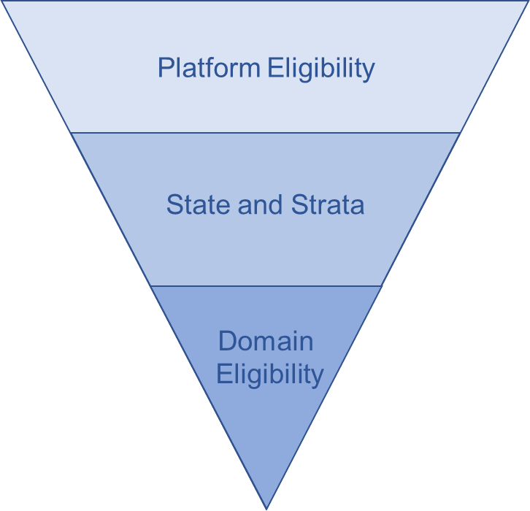
5. Patient, Pathogen and Disease Appendix
(PANDA)
Describes how specific patient, pathogen, disease, illness severity and additional clinical features are defined and categorized
Does not include information about interventions
PANDA may be amended in the context of a future pandemic, but it is intended that any amendments to the PANDA will be infrequent
10
Notes:
NOTE: defines factors including characteristics of the patient (e.g. age), disease (e.g. pneumonia present or absent), and likely pathogen (influenza, SARS-CoV-2, bacterial infection, etc.)

Slide 20
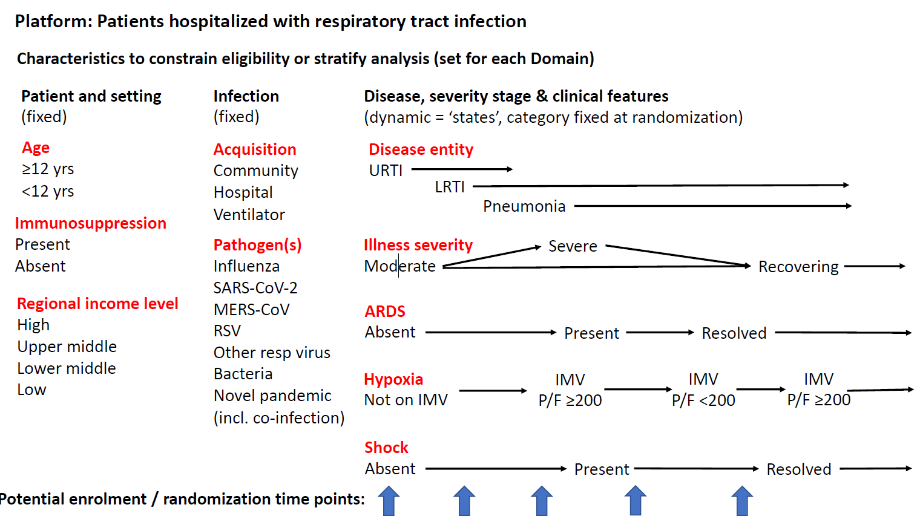
≥ 18 yrs
≥ 12 yrs ≤ 18 yrs
≥ 28 days ≤ 12 yrs
11
Notes:
NOTE:
For audio:
Patients are categorised according to:
Where their infection was acquired (in hospital, or in the community)
Location of respiratory tract infection (upper- or lower-respiratory tract)
Presence or absence of pneumonia
Causative organism
Presence or absence of Acute Hypoxemic Respiratory Failure, Hypoxaemia, Acute Respiratory Distress Syndrome, or shock

Slide 21
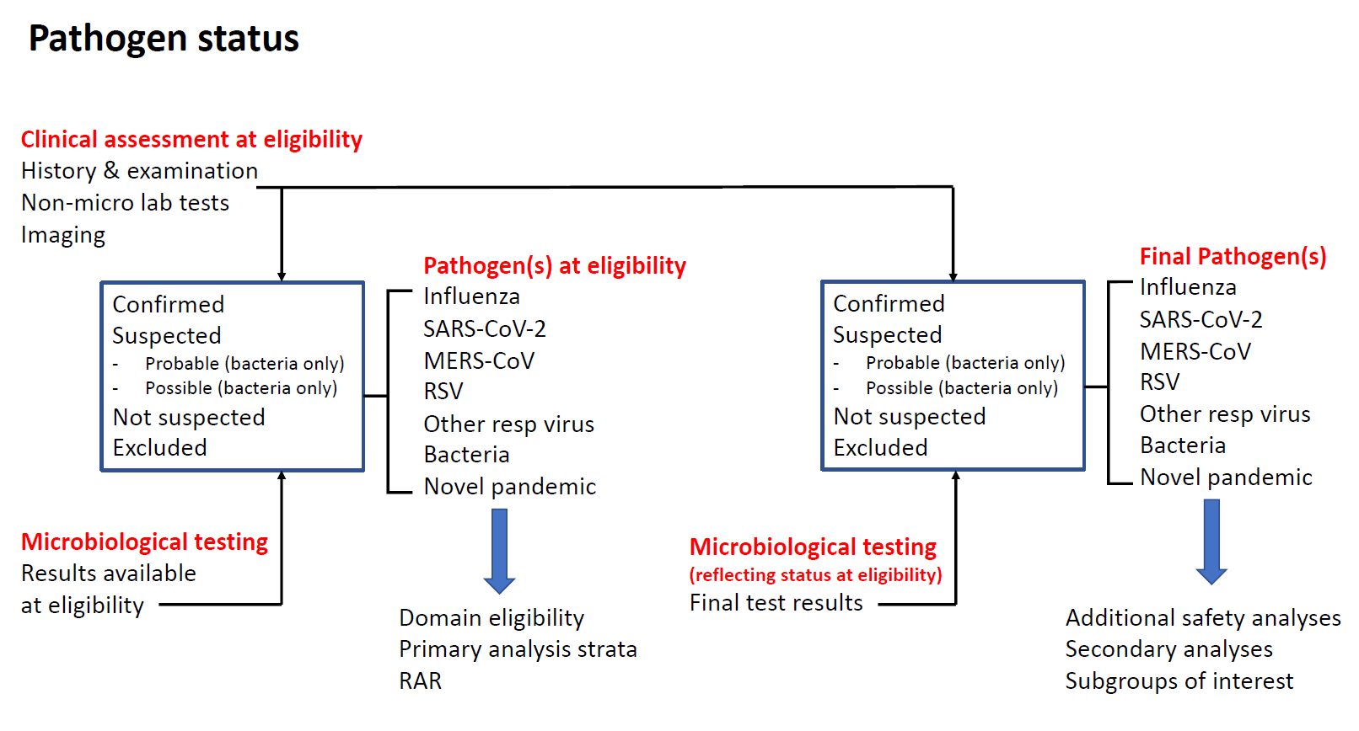
12
Notes:
NOTE:
Include in audio:
At platform level, pathogen status for eligibility may be assigned based on clinical assessment, microbiological testing, or both.
Each DSA will specify which pathogens are relevant to the domain. For each pathogen, a hierarchy of infection likelihood exists consisting of ‘confirmed’, ‘suspected’ (for bacterial infection, into two subcategories: ‘probable’ and ‘possible’), ‘not suspected’, and ‘excluded’ based on the clinical assessment and microbiological test results.
For the ‘confirmed’ or ‘excluded’ options to be selected, there must be supportive microbiological testing.
Domains may also constrain eligibility according to additional criteria related to the nature of the sample, the time-window in which the sample is collected, and testing types.
A domain can restrict eligibility by specifically including or excluding patients with a specific pathogen status e.g. a domain could include participants with influenza virus infection, exclude patients with confirmed SARS-CoV-2 infection and exclude participants who have bacterial co-infection

Slide 22
6. Clarification for Transferred Patients
Core Protocol V4 clarifies protocol adherence for participants who are transferred between locations.
If a participant is transferred from a participating location to:
a non-participating hospital
a non-participating clinical area within a participating hospital
a participating hospital/clinical area that is not participating in the domain/intervention to which the participant has been allocated
Continuation or discontinuation of allocated interventions becomes a clinical decision, rather than an intervention administered under trial protocols.
13
Notes:
NOTE:

Slide 23
7. PedsQL at Day 180 Follow-up for Paediatrics
Paediatric quality of life questionnaire, by age group:
<2 yrs = none/not applicable
2-4 yrs - completed by parent
5-7 yrs - completed by parent or child
8-12 yrs - completed by parent or child
13-18 yrs - completed by parent or child
(REMAP-CAP defines a paediatric up until 17yrs but they may turn 18 during follow up period)
4 x Qs on physical, emotional, social and daycare/nursery/school functioning.
14
Notes:
NOTE:

Slide 24
8. Recovering State
Core Protocol V4 adds the Recovering State
The Recovering State is defined as:
  Hospitalised patients who, in the opinion of the treating clinician, are clearly recovering from their acute respiratory tract infection AND are unlikely to require or receive a significant escalation in level of organ failure support for the remainder of their hospital admission
Currently no domains are available for patients in the Recovering State, meaning that they cannot be randomised into the Platform
  Future domains may permit enrolment of patients in the Recovering State
15
Notes:
NOTE:

Slide 25
9. Statistics
Merge of two statistical models (interpandemic and pandemic), & possibly Ventilation Domain
New trigger terminology added
  - Possible treatment effects : superiority, efficacy, inferiority, equivalence, noninferiority, futility, and harm
  - Core protocol sets default thresholds for statistical triggers
Adaptive analyses will occur frequently, approximately proportional to the rate of recruitment
Response Adaptive Randomization: proportions are determined by analysis of the available data informing the primary outcome measure in participants after at least 28-days of follow-up
  - For domains with only two available interventions, default is that RAR will not be applied
  - Allocation proportions capped at 60% for two-intervention domains, unless otherwise specified
16
Notes:
NOTE:

Slide 26
REMAP-CAP
Domain Specific Appendices

Slide 27
Refer to DSAs for:
Domain specific eligibility criteria
Domain rationale
Concomitant care
Potential domain-specific adverse events
Domain-specific endpoints
Domain-specific protocol deviations
Other domain specific information
18
Notes:
NOTE:

Slide 28
General Domain Updates
The broadening of Platform-level eligibility criteria mean that domain-level eligibility criteria wording has been updated to ensure continuity and correct domain constraints:
    Removal of pandemic/non-pandemic strata in all DSAs.
    Addition of age strata in relevant DSAs (flu domains).
    Consistency in mention of the moderate state in steroid and antiviral DSAs.
Although it may look like there are a lot of changes, in practice the patients who are eligible for these domains will be the same as were eligible under previous versions.
In most cases there are no changes to interventions or their delivery.

Slide 29
Domain | Moderate State | Severe State | Paediatric (≥28 days) | Adolescent (≥12 years) | Adult (≥18 years)
Antibiotic Domain | 🗶 | ✔ | 🗶 | 🗶 | ✔
Macrolide Duration Domain | 🗶 | ✔ | 🗶 | 🗶 | ✔
Corticosteroid Domain | ✔ | ✔ | ✔ | ✔ | ✔
Influenza Antiviral Domain | ✔ | ✔ | ✔ | ✔ | ✔
Immunoglobulin Domain | ✔ | ✔ | 🗶 | ✔ (≥16 years) | ✔
Mechanical Ventilation Domain | 🗶 | ✔ - n/a UK | 🗶 | 🗶 | ✔ - n/a UK
Endothelial Domain | 🗶 | ✔- n/a UK | 🗶 | 🗶 | ✔ - n/a UK
Influenza Immune Modulation Domain | 🗶 | ✔ | ✔ (≥2 years) | ✔ | ✔
20
Notes:
NOTE:

Slide 30
Domain Eligibility Changes
Steroid eligibility
CAP is removed from platform incl. criteria, but added to steroid domain incl. criteria for severely ill patients
Patients must have a lower resp. tract infection (platform is open to lower and upper)
Confirmed SARS-CoV-2 infection is an exclusion
Hospital-acquired respiratory tract infection is an exclusion except for flu
Antiviral eligibility – no changes
Immune modulation eligibility
Removed from platform exclusion and added to domain exclusion:
More than 48 hours has elapsed since commencement of sustained organ failure support

Slide 31
REMAP-CAP eCRF for Core Protocol V4.0

Slide 32
eCRF Changes
The REMAP-CAP case report form (CRF) has undergone a thorough review and substantial update. These changes are intended to:
  Reflect changes to Core Protocol V4
  Reduce burden of data collection by removing unnecessary fields / finding more efficient ways of capturing necessary data; and
  Future-proof for any future public health emergencies
23
Notes:
NOTE:

Slide 33
Eligibility Form Changes
The eligibility assessment was updated to:
  Reflect the reduced Platform eligibility criteria
  Reflect modifications to domain-specific eligibility criteria
  Manage the complexity of simultaneously assessing eligibility for multiple domains and interventions
24
Notes:
NOTE:

Slide 34

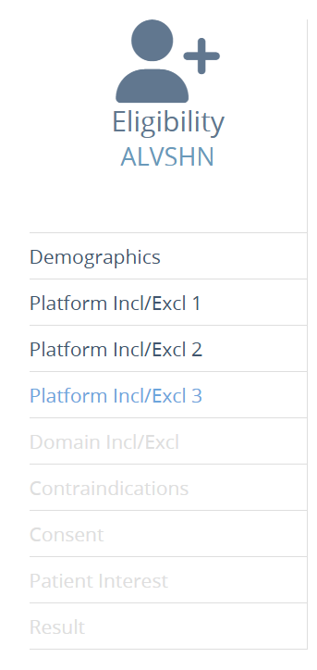
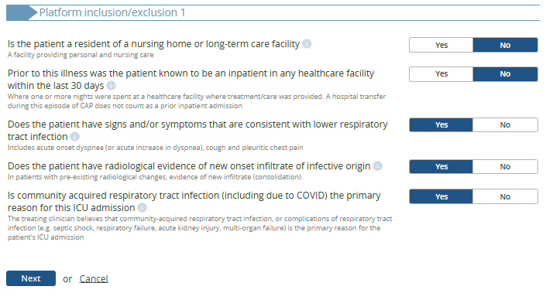
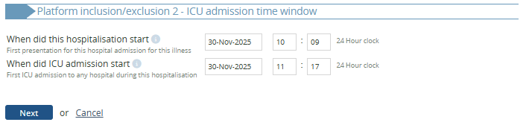
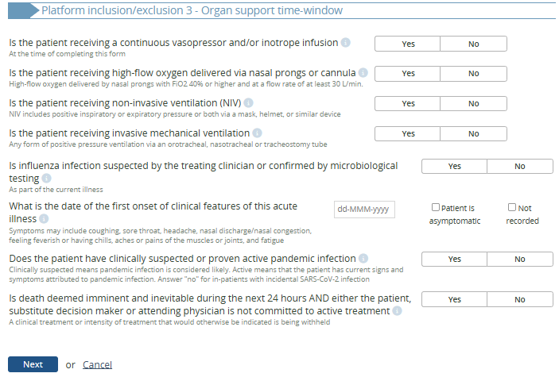

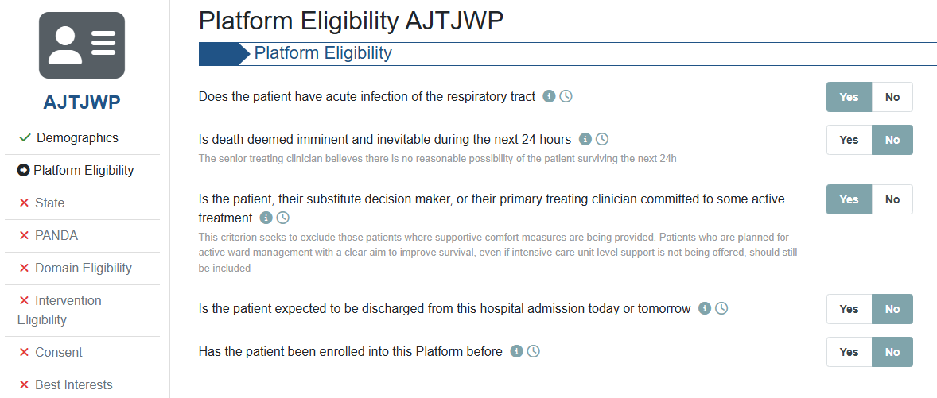
  Used to be ±20 platform eligibility questions on 3 pages
  5 platform eligibility questions on 1 page
  New system
  Old system
  Fewer questions necessary to assess Platform eligibility
25
Notes:
NOTE:

Slide 35
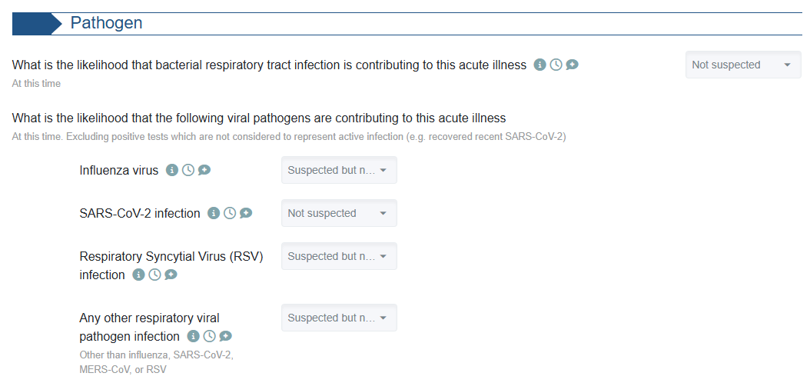
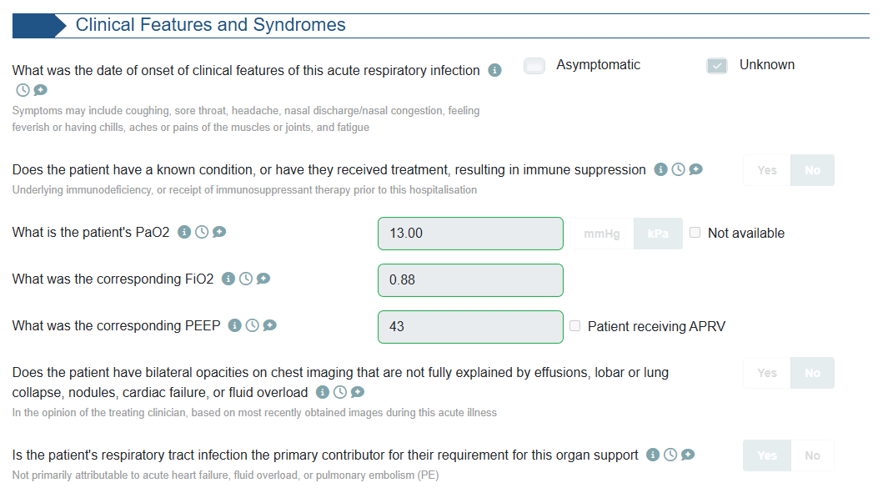
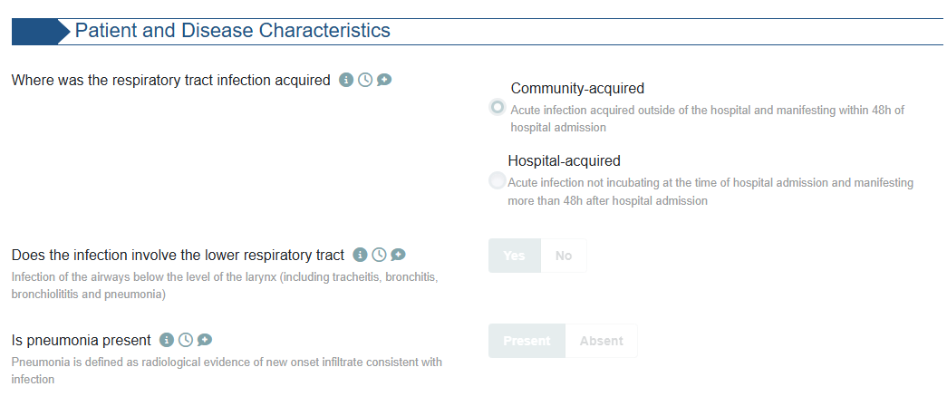
  New pages added for “PANDA”, to continue eligibility assessment based on…
  New system
26
Notes:
NOTE:

Slide 36
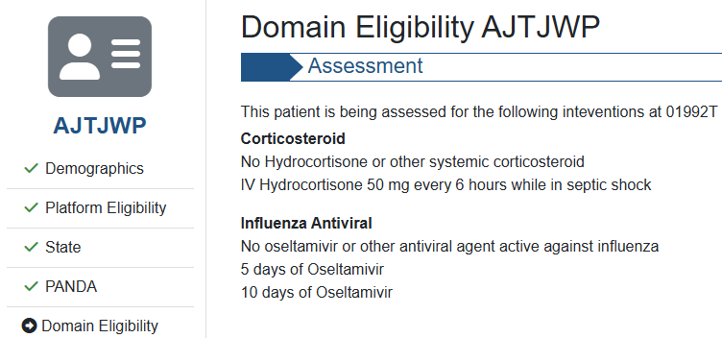

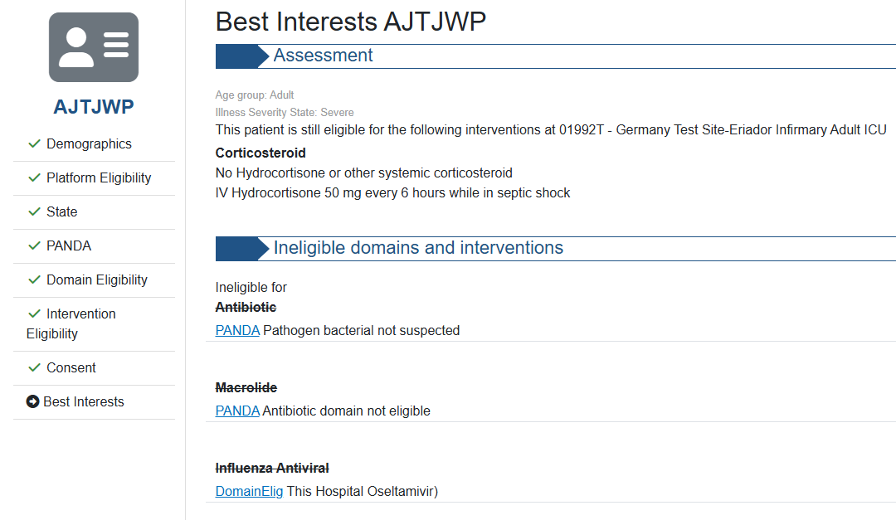
  Clearer output for users regarding which domains a participant is being assessed for on the “Domain Eligibility” page…
  New system
  … and why participants are ineligible for certain domains on the “Best Interests” page.
  New system
27
Notes:
NOTE:

Slide 37
Re-assessment of Eligibility
Patients who have been randomised in the Moderate State may be eligible to be randomised again to additional domains if they progress to the Severe State.
However, patients cannot be randomised in the Moderate State AFTER the Severe State.
To reassess a participant’s eligibility for domains in the Severe State, navigate to the patient summary page.
28
Notes:
NOTE:

Slide 38
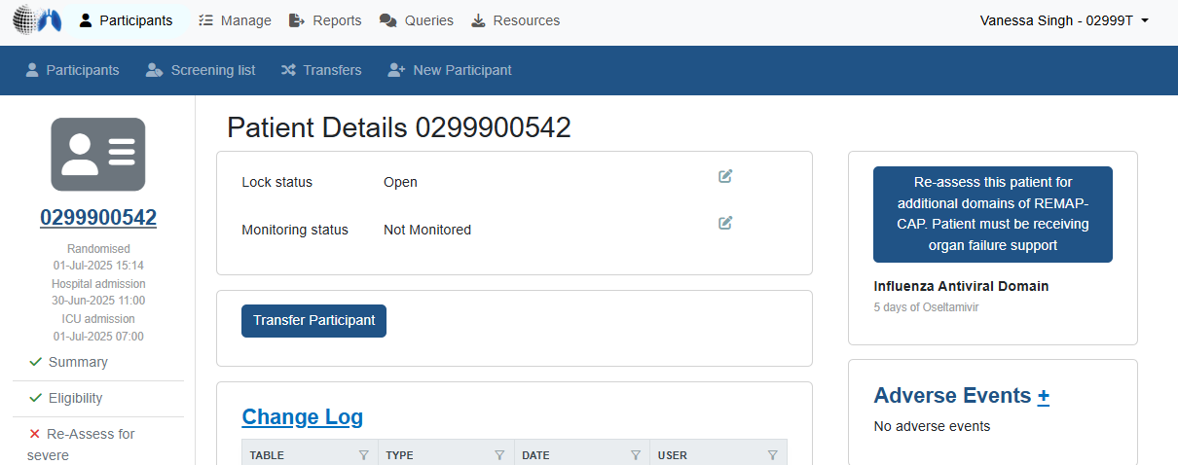
29
Notes:
NOTE:

Slide 39
Consent Form Changes
Qs re patient capacity and PerLR/ProLR made clearer to avoid accidental randomisations
For paediatrics, ‘proxy’ consent should be selected if the parent is providing consent
Can indicate why written consent wasn’t obtained from child participant i.e. did not have capacity (if too young/can’t fully understand) or enter your own free text if preferred under ‘another reason’ option
‘Best interest’ statement added for emergency enrolment of patients without any consent in place i.e. Patient has no capacity, PerLR/ProLR is not available, and timeframe is running out.
Reminder: ALL consent discussions mentioned in source notes must be entered on eCRF even if there is no outcome/no decision made!
30
Notes:
NOTE:
Include in audio:
Outcome options include:
Agreed/declined/info provided, no decision made
How outcome was provided is also recorded – in writing, verbal. If verbal was there a witness, did witness sign a CF.
Which domains agreed to.
Q - Date of ethics committee / regulatory approval to use data in the absence of written consent – enter N/A for this

Slide 40
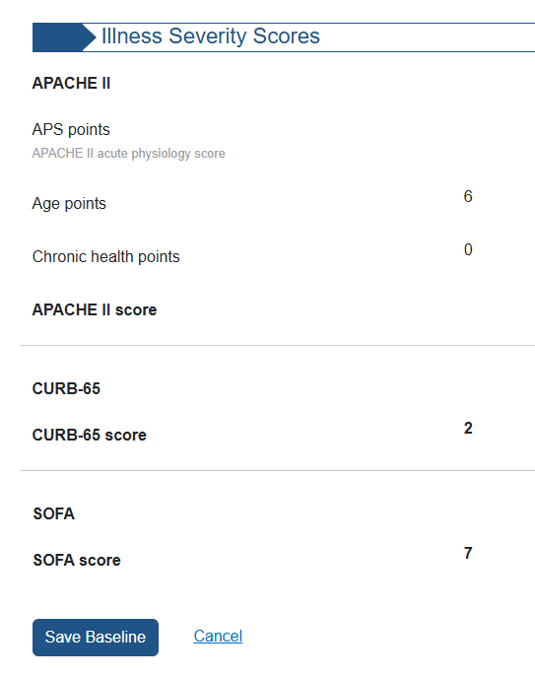
Baseline Form Changes
Some questions in the Baseline Form have been made domain-specific.
Some questions in the Baseline Form have been removed.
Illness Severity Scores are now calculated automatically by the database for ICU patients, based on data entered in the Baseline Form.
  New system
31
Notes:
NOTE:
Audio:
Some questions have been made domain-specific > e.g. pregnancy, type of immune-suppressive therapy, COVID-19 / Influenza vaccination status.
Some questions have been removed > e.g., hospital admission source, smoking status, hazardous alcohol consumption, whether the patient is a healthcare worker.

Slide 41
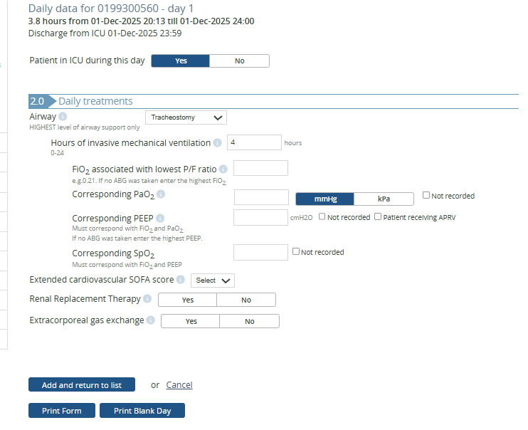
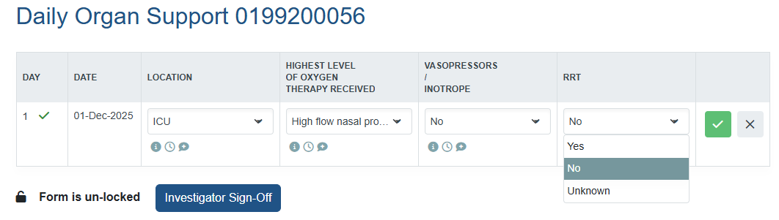
Daily Data Form Changes
Focus on organ support.
Study days are now defined by calendar days instead of ICU chart days.
Yes/No questions about organ support received on each study day
  Old system
  New system
32
Notes:
NOTE:

Slide 42
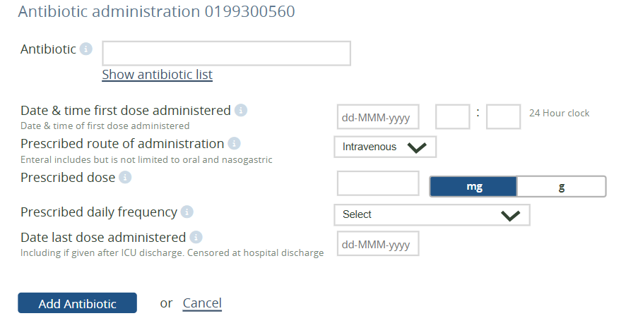
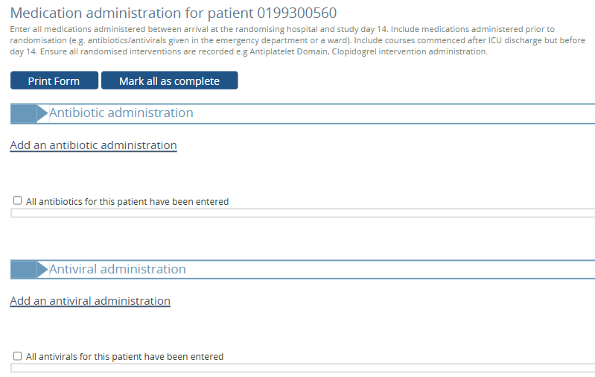
Medication Form Changes
Focus on daily administration of allocated intervention, instead of details of each prescribed course.
  Old system
  New system
33
Notes:
NOTE:

Slide 43
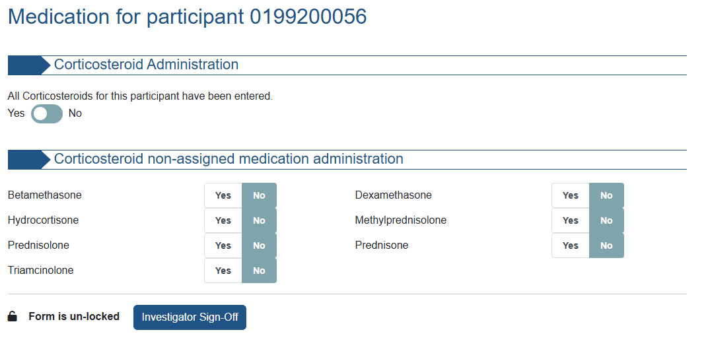
Non-study medications of interest will be collected in a simplified “Yes / No” format.
Data collection will be domain-specific.
  New system
34
Notes:
NOTE:

Slide 44
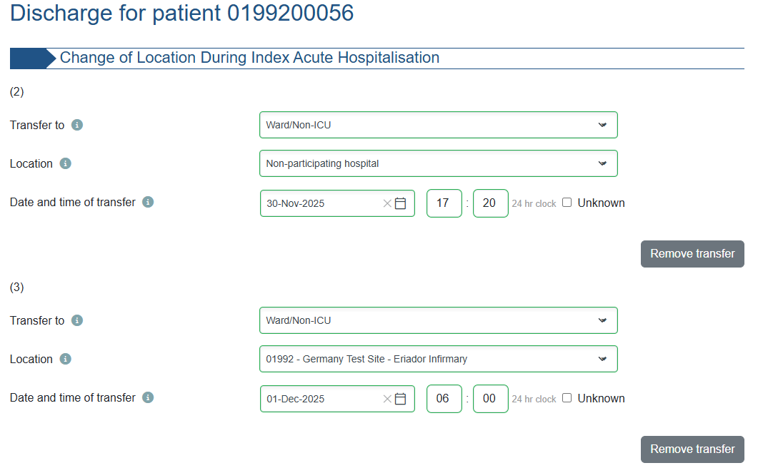
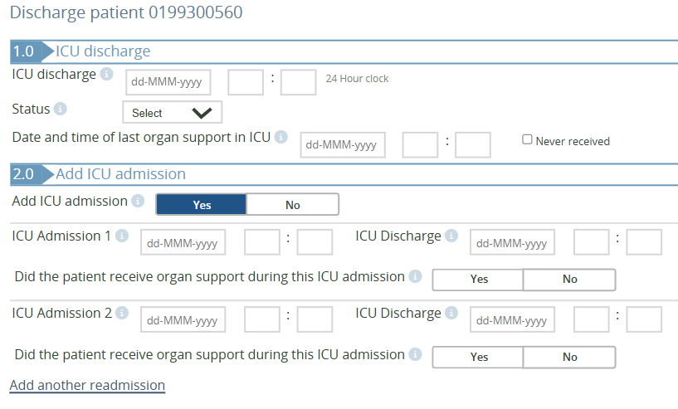
Discharge Form Changes
Modified to more clearly capture participant movement during the acute hospital admission, including between hospitals in case of transfers.
Cause of death will be collected for paediatric participants who die in hospital.
  New system
  Old system
35
Notes:
NOTE:

Slide 45
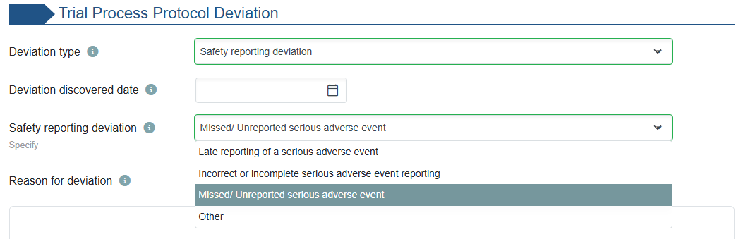
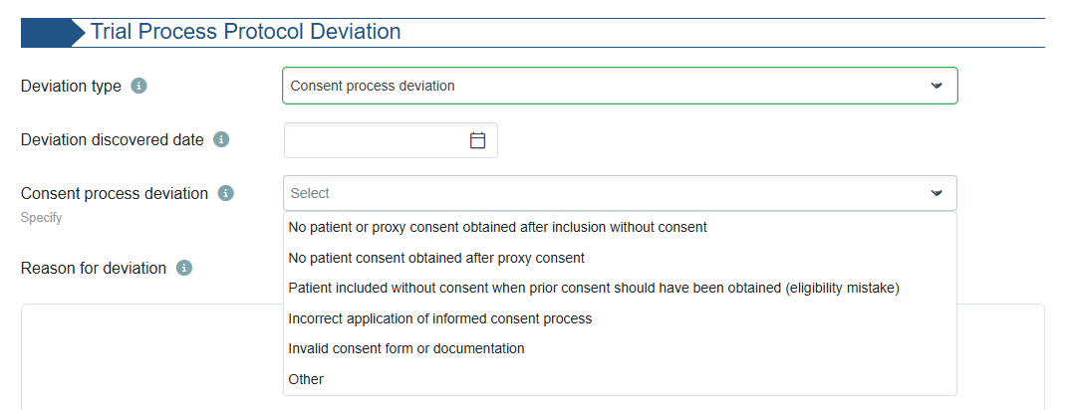
Protocol Deviation Form Changes
The Protocol Deviation Form now allows entries that relate to trial processes, including safety reporting and consent processes.
  New system
36
Notes:
NOTE:

Slide 46
D90 & D180 Follow Up
Survival status will continue to be collected at D90 and D180
Questionnaires will continue to be collected at D180:
Adults D180 | Paediatrics D180
EQ-5D-5L | EQ-5D-Y
WHODAS | PedsQL SF15 - New
37
Notes:
NOTE:
EQ5D – QOL
WHODAS – disability status
PedsQL – also QOL

Slide 47
New Form: Pregnancy Outcome
Pregnancy status at hospital discharge if part of Immune Modulation domain
If no longer pregnant at hospital discharge, complete from medical records
If pregnant at hospital discharge, follow up at d180 unless info is available earlier from medical records
If still pregnant at d180, complete additional follow up approx. 6 weeks after delivery due date
Qs include neonatal outcome, date, birth weight, sex, NICU admission info, neonatal status 1 month post birth, anomalies at delivery.
38
Notes:
NOTE:

Slide 48
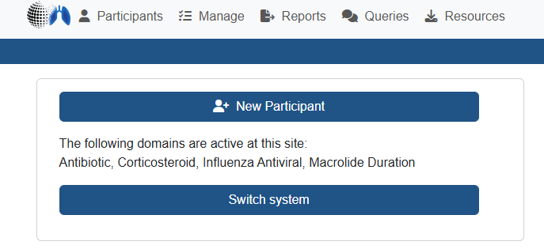
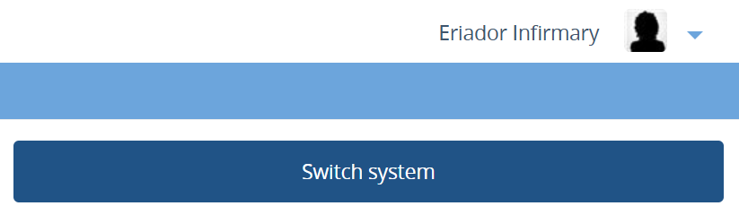
Old vs. New Database
Once your site is activated for Core Protocol V4.0, your eCRF accounts will be linked to the new database system.
You can access the entered eCRF data under both database systems by selecting the “Switch System” button on your landing page.
  New system
  Old system
39
Notes:
NOTE:

Slide 49
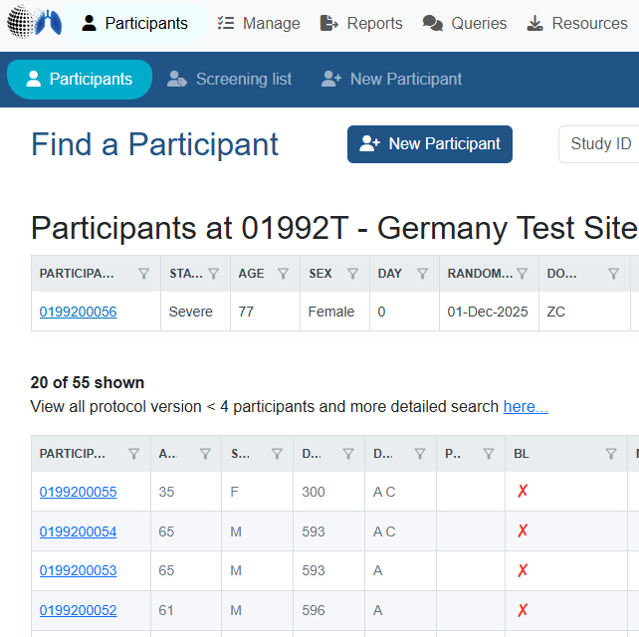
Only new patients recruited under Core Protocol V4.0 are saved in the new database system.
Previously enrolled participants under Core Protocol V3.1 remain in the old database system.
No reconsent is needed for patients recruited under Core V3.1 (no changes in protocol).
  New system
40
Notes:
NOTE:

Slide 50
Email Notifications
Updated format for randomisation email notifications:
Site code in email body will include a letter denoting site type (adult ICU/ward or paed ICU/ward) i.e. A, B, C, D or T for test site
2-character domain codes will replace the previous single letter domain code
Illness Severity State (“moderate” or ”severe”) will replace previous text of “Pandemic infection not suspected or confirmed” and ‘Pandemic infection suspected or confirmed”
38
Notes:
NOTE:
Site code and letter matches on the eCRF – example shown for St Mary’s Hospital
2 char
Illness Severity State (“moderate” or ”severe”) will replace previous text classifying patients by pandemic or non-pandemic infection

Slide 51
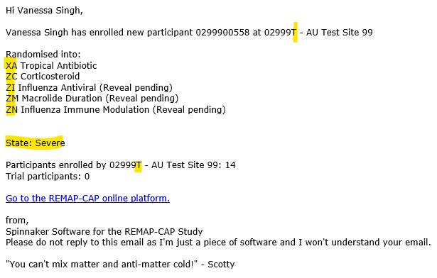
38
Notes:
NOTE: Example rand notification email

Slide 52
REMAP-CAP
IMP Procedures

Slide 53
Labelling
Under CTD, there was national variation in labelling requirements for IMP. With the CTR (EU), clinical trials are assessed uniformly across all Member States. As a result, our labelling strategy is now aligned across all EU countries. Authorized IMP used on- or off-label will not be labelled.
IMP that is supplied by pharmaceutical companies will be supplied with a label.
53
Notes:
NOTE: Omission of the simplified label applies to Belgium, Czech Republic, Ireland, Netherlands Italy and Slovenia - n/a for UK
CTD: Cinical Trials Directive (former EU rules)
CTR: Clinical Trials Regulation – EU rules
CTD replaced CTR

Slide 54
IMP Procedures
Baloxavir & Tocilizumab are provided by Roche from clinical trial stock and is supplied with clinical trial labelling.
All other IMP are from hospital stock.
For IMP from external suppliers (Roche):
  Training on ordering, temperature and storage monitoring, drug accountability and destruction is provided prior to activation of domains. Study templates also provided.
For IMP from hospital stock: Site’s routine procedures to be followed for drug accountability, temperature monitoring and destruction
  As long as information is clearly captured and accountability can be monitored from drug charts/medical notes
42

Slide 55
REMAP-CAP
Safety

Slide 56
Safety Reporting
Safety event definitions were updated in the protocol.
Reminder: Only protocol defined SAEs need to be reported
  1. SAEs deemed to be possibly, probably or definitely related to study treatment / participation.
  2. Pre-specified SAEs listed in the DSAs
Reminder: It is expected that site investigators make an initial (documented) assessment on event severity, relatedness and expectedness:
  An SAE is considered ‘expected’ if the nature and severity of the event is consistent with the current approved version of the reference safety information (SmPCs).
  Expectedness should be assessed “from the perspective of previously observed, not on the basis of what might be anticipated from the pharmacological properties of a medicinal product” (ICH E2A, 1994).
44
Notes:
NOTE:
Include in audio:
Reference Safety information: (e.g., summary of product characteristics / investigator brochure / protocol documents).

Slide 57
REMAP-CAP
Informed Consent

Slide 58
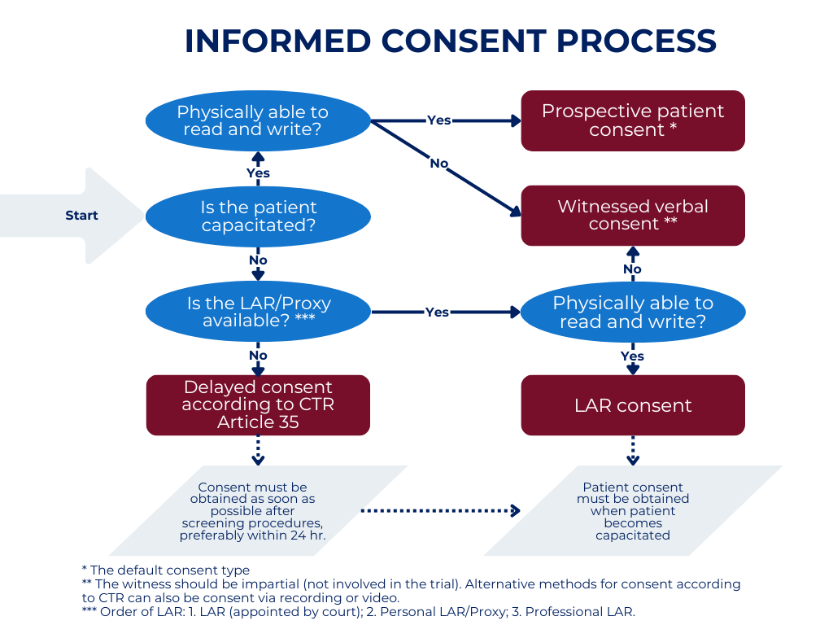
Informed Consent
Obtaining Informed Consent in an emergency setting is now described in the EU RSA V4 for all countries and aligned with CTR requirements.
EU RSA: UK Country Annex lists approved consent types and procedures, as described in refresher training session.
* Prospective patient consent is the default consent type.
** In case of verbal/telephone consent, the witness should be impartial (not involved in the trial). Alternative methods for consent include watching a video, or summary IS.
*** Order of Legal Representative priority:
    Legal rep appointed by court (adults/children) or parent (children)
    Personal Legal Rep (adults)
    Professional Leg Rep (adult/children)
46
Notes:
Include in audio:
For participants that remain incapacitated at hospital discharge, sites are expected to check at least at day 90 and day 180 if the subject has regained capacity to provide consent, if still alive.
Must seek telephone consent first as well as posting out written consent, incase it is not returned.

Slide 59
REMAP-CAP
ICH-GCP

Slide 60
ICH-GCP E6 R3
Effective date for Revision 3 was 23rd July 2025 in the EU.
Mandatory in the UK as of 28th April 2026.
Please file your (updated) GCP certificates in the ISF and share with Trial Management team for TMF filing, by end of April 2026!
48
Notes:
NOTE:

Slide 61
REMAP-CAP
Practical Information

Slide 62

What’s Next?
Expected from sites:
Attend Core Protocol V4 Transition training / self-train via slides
Provide (self-) training logs for:
  Core protocol v4 transition training
  Protocol v4 and associated documents
  Updated DSAs
Complete Protocol Signature Page and Choice Pages
Complete Spiral Database Form
All the above to be filed in ISF
GREEN LIGHT
50
Notes:
NOTE:

Slide 63
Provided to sites by us:
Self-training logs with all mandatory documents/slide decks listed for self-training
Updated eCRF guides and associated eCRF documents
Protocol documents and PIS/CFs (already sent as part of Am43 and on the study website under Protocol v4 training module)
Site staff should be trained on Core V4 and provide all documents before conducting any Core V4 trial-related tasks!!!
51
Notes:
NOTE:
Include in audio:
It is the responsibility of the PI to ensure all site study staff have been trained on Core V4 before performing any Core V4 study related tasks!

Slide 64
REMAP-CAP
AoB

Slide 65
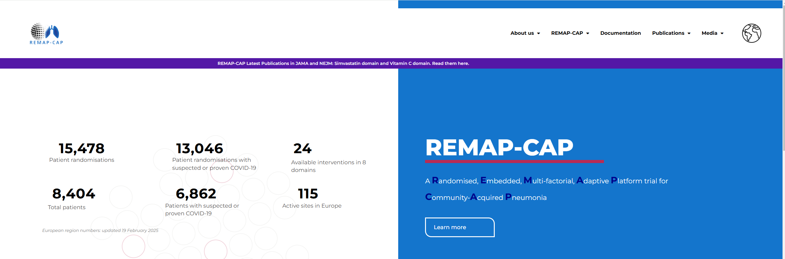
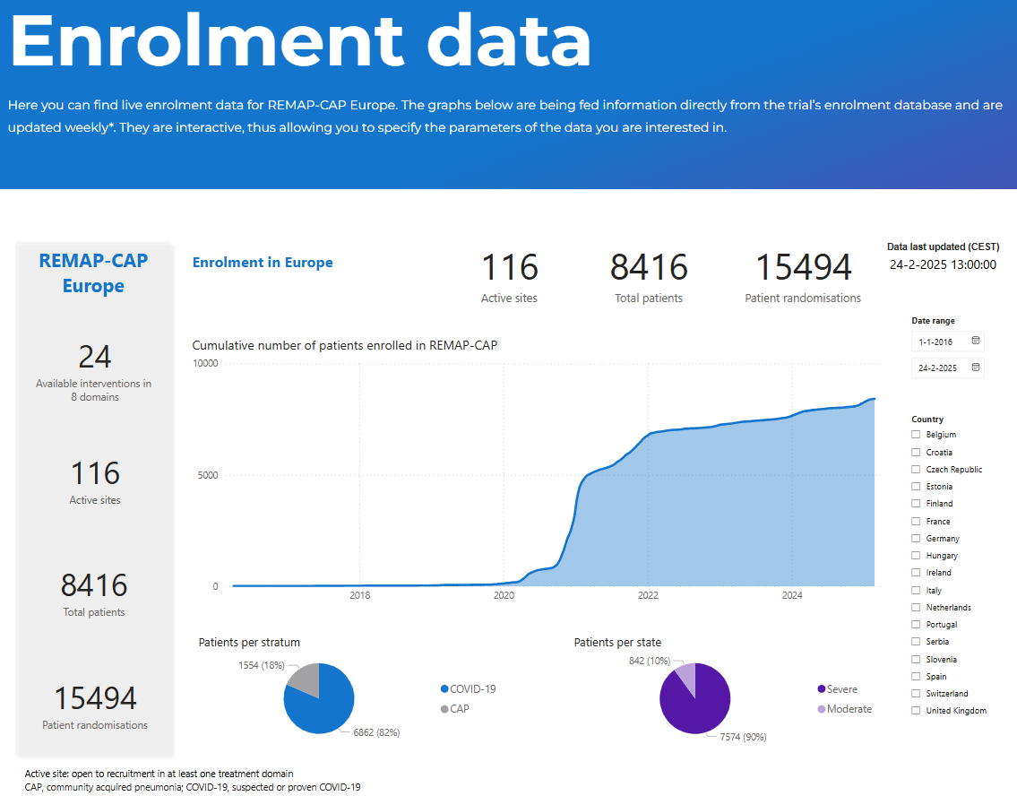
Stay Up-to-date
www.remapcap.co.uk
Newsletters
Instagram https://www.instagram.com/remapcap/
LinkedIn https://www.linkedin.com/company/remap-cap/mycompany/
53
Notes:
NOTE:
Add to audio:
We are updating the website and arrangement of documents to make them easier to find.
Protocol v4 training manual is currently being built.
Training modules will later be split into smaller videos for different roles/responsibilities, taking on board feedback we previously received about length of training.

Slide 66
Contacts
General e-mail address (always in cc):
ukremap-cap@icnarc.org
Our team:
Aisha Anjum - Trial Manager
Janis Best-Lane - Senior Trial manager
Lucy Stronach - Trial Coordinator/Monitor
Millie Parke - Trial Coordinator/Monitor
Ashley Alexander - Trial Admin/Monitor
Lindsay Jack - Trial Monitor
Tina Reetun - Trial Monitor
For urgent situations outside office hours if UK team cannot be reached
info@remapcap.org
54
Notes:
NOTE:

Slide 67
THANK YOU!
55
Notes:
NOTE:

